Slide 1
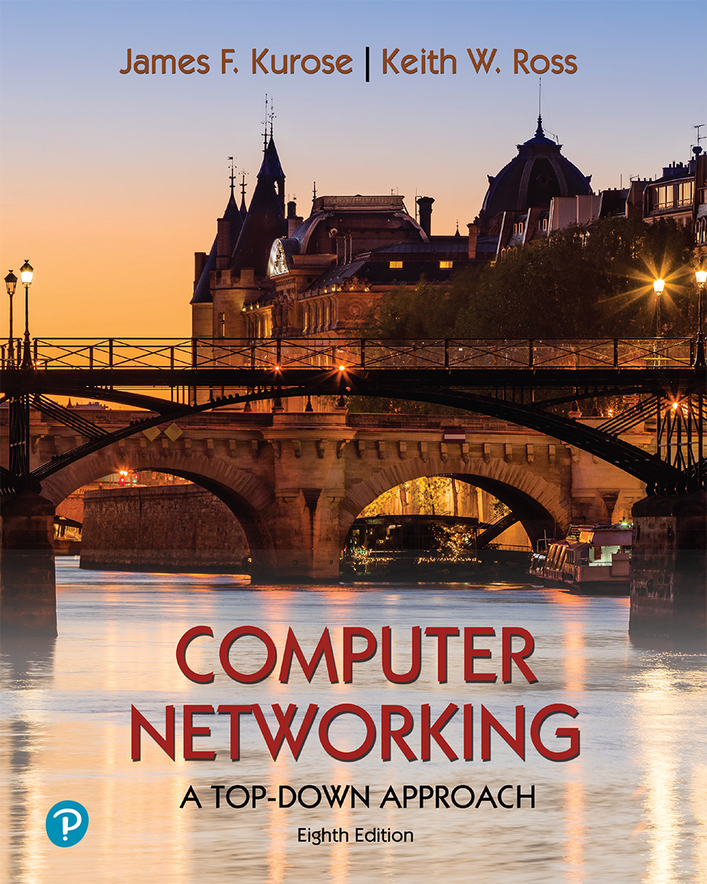
Chapter 8 Security
Computer Networking: A Top-Down Approach 8th edition Jim Kurose, Keith Ross Pearson, 2020
Acknowledgement: Based on the textbook’s website: https://gaia.cs.umass.edu/kurose_ross/index.php
Notes:
Version History
8.0 (May 2020)
All slides reformatted for 16:9 aspect ratio
All slides updated to 8th edition material
Use of Calibri font, rather that Gill Sans MT
Add LOTS more animation throughout
lighter header font
wireless security completely redone (updated WiFi and added 4G/5G)
SSL material replaces by TLS 1.3 (up-to-date)
V8.2 (Feb 2022)
Minor corrections

Slide 2
Outline
Overview
Symmetric encryption
Public-key cryptography
Message authentication and hash functions
Digital signatures
Random and pseudorandom numbers
Notes:
Confidentiality with symmetric encryption
Symmetric encryption
Symmetric block encryption algorithms
Stream ciphers
Message authentication and hash functions
Authentication using symmetric encryption
Message authentication without message encryption
Secure hash functions
Other applications of hash functions
Random and pseudorandom numbers
The use of random numbers
Random versus pseudorandom

Slide 3
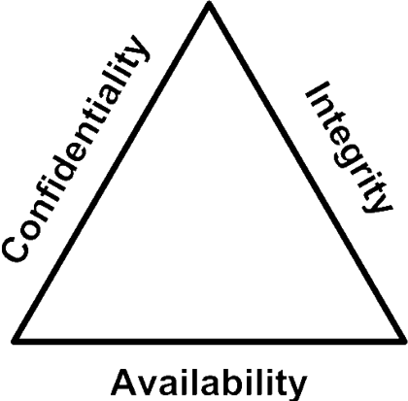
The CIA Triad
Confidentiality:
Data confidentiality: Assures that private or confidential information is not made available or disclosed to unauthorized individuals, i.e., no snooping or wiretapping
Privacy: Assures that individuals control what information related to them may be collected and stored and by whom and to whom that information may be disclosed.
Integrity:
Data integrity: Assures that information and programs are changed only in a specified and authorized manner, e.g., message received = message sent
System integrity: Assures that a system performs its intended function in an unimpaired manner, free from deliberate or inadvertent unauthorized manipulation of the system.
Availability: Assures that systems work promptly and service is not denied to authorized users.
Notes:
CIA:
Integrity: Received = sent
Availability: Legal users should be able to use it.
Confidentiality and Privacy: No snooping or wiretapping
Confidentiality
Preserving authorized restrictions on information access and disclosure, including means for protecting personal privacy and proprietary information
Integrity
Guarding against improper information modification or destruction, including ensuring information nonrepudiation and authenticity
Availability
Ensuring timely and reliable access to and use of information

Slide 4
CIA Examples
Notes:
Mechanisms to achieve CIA
Authentication: You are who you say you are.
Authorization = Access Control Only authorized users get to the data.
Non-repudiation: Neither the sender nor the receiver can deny the existence of a message.
HARDWARE A major threat to computer system hardware is the threat to
availability. Hardware is the most vulnerable to attack and the least susceptible to
automated controls. Threats include accidental and deliberate damage to equipment
as well as theft. The proliferation of personal computers and workstations and the
widespread use of LANs increase the potential for losses in this area. Theft of
CD-ROMs and DVDs can lead to loss of confidentiality. Physical and administrative
security measures are needed to deal with these threats.
SOFTWARE Software includes the operating system, utilities, and application
programs. A key threat to software is an attack on availability. Software, especially
application software, is often easy to delete. Software can also be altered or
damaged to render it useless. Careful software configuration management, which
includes making backups of the most recent version of software, can maintain high
availability. A more difficult problem to deal with is software modification that
results in a program that still functions but that behaves differently than before,
which is a threat to integrity/authenticity. Computer viruses and related attacks fall
into this category. A final problem is protection against software piracy. Although
certain countermeasures are available, by and large the problem of unauthorized
copying of software has not been solved.
DATA Hardware and software security are typically concerns of computing center
professionals or individual concerns of personal computer users. A much more
widespread problem is data security, which involves files and other forms of data
controlled by individuals, groups, and business organizations.
Security concerns with respect to data are broad, encompassing availability,
secrecy, and integrity. In the case of availability, the concern is with the destruction
of data files, which can occur either accidentally or maliciously.
The obvious concern with secrecy is the unauthorized reading of data files or
databases, and this area has been the subject of perhaps more research and effort
than any other area of computer security. A less obvious threat to secrecy involves
the analysis of data and manifests itself in the use of so-called statistical databases,
which provide summary or aggregate information. Presumably, the existence of
aggregate information does not threaten the privacy of the individuals involved.
However, as the use of statistical databases grows, there is an increasing potential
for disclosure of personal information. In essence, characteristics of constituent
individuals may be identified through careful analysis. For example, if one table
records the aggregate of the incomes of respondents A, B, C, and D and another
records the aggregate of the incomes of A, B, C, D, and E, the difference between
the two aggregates would be the income of E. This problem is exacerbated by the
increasing desire to combine data sets. In many cases, matching several sets of data
for consistency at different levels of aggregation requires access to individual units.
Thus, the individual units, which are the subject of privacy concerns, are available at
various stages in the processing of data sets.
Finally, data integrity is a major concern in most installations. Modifications
to data files can have consequences ranging from minor to disastrous.

Slide 5
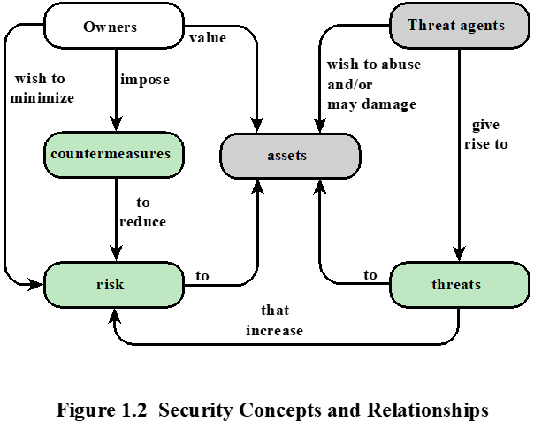
Vulnerabilities, Threats and Attacks
Categories of vulnerabilities
Corrupted (loss of integrity)
Leaky (loss of confidentiality)
Unavailable or very slow (loss of availability)
Threats
Capable of exploiting vulnerabilities
Represent potential security harm to an asset
Attacks (threats carried out)
Insider vs. outsider
Passive vs. active
Notes:
– attempt to learn or make use of information from the system that does not affect system resources
Active – attempt to alter system resources or affect their operation
In the context of security, our concern is with the vulnerabilities of system
resources. [NRC02] lists the following general categories of vulnerabilities of a
computer system or network asset:
• It can be corrupted , so that it does the wrong thing or gives wrong answers.
For example, stored data values may differ from what they should be because
they have been improperly modified.
• It can become leaky . For example, someone who should not have access to
some or all of the information available through the network obtains such
access.
• It can become unavailable or very slow. That is, using the system or network
becomes impossible or impractical.
These three general types of vulnerability correspond to the concepts of integrity,
confidentiality, and availability, enumerated earlier in this section.
Corresponding to the various types of vulnerabilities to a system resource are
threats that are capable of exploiting those vulnerabilities. A threat represents a
potential security harm to an asset. An attack is a threat that is carried out (threat
action) and, if successful, leads to an undesirable violation of security, or threat
consequence. The agent carrying out the attack is referred to as an attacker, or
threat agent . We can distinguish two types of attacks:
• Active attack: An attempt to alter system resources or affect their operation.
• Passive attack: An attempt to learn or make use of information from the
system that does not affect system resources.
We can also classify attacks based on the origin of the attack:
• Inside attack: Initiated by an entity inside the security perimeter (an “insider”).
The insider is authorized to access system resources but uses them in a way not
approved by those who granted the authorization.
• Outside attack: Initiated from outside the perimeter, by an unauthorized or
illegitimate user of the system (an “outsider”). On the Internet, potential
outside attackers range from amateur pranksters to organized criminals, international
terrorists, and hostile governments.

Slide 6
Passive Attacks
In passive attacks, attacker attempts to learn or make use of information from the system but does not affect system resources
Eavesdropping on, or monitoring of, transmissions
Goal of attacker is to obtain information that is being transmitted
Two categories :
Leaking of message content
Traffic analysis: attacker infers information from network traffic patterns, even though message content is not leaked (e.g., with encryption)
Notes:
Network security attacks can be classified
as passive attacks and active attacks . A passive attack attempts to learn or make
use of information from the system but does not affect system resources. An active
attack attempts to alter system resources or affect their operation.
Passive attacks are in the nature of eavesdropping on, or monitoring of,
transmissions. The goal of the attacker is to obtain information that is being transmitted.
Two types of passive attacks are release of message contents and traffic
analysis.
The release of message contents is easily understood. A telephone conversation,
an electronic mail message, and a transferred file may contain sensitive or
confidential information. We would like to prevent an opponent from learning the
contents of these transmissions.
A second type of passive attack, traffic analysis , is subtler. Suppose that we
had a way of masking the contents of messages or other information traffic so that
opponents, even if they captured the message, could not extract the information
from the message. The common technique for masking contents is encryption. If we
had encryption protection in place, an opponent might still be able to observe the
pattern of these messages. The opponent could determine the location and identity
of communicating hosts and could observe the frequency and length of messages
being exchanged. This information might be useful in guessing the nature of the
communication that was taking place.
Passive attacks are very difficult to detect because they do not involve any
alteration of the data. Typically, the message traffic is sent and received in an
apparently normal fashion and neither the sender nor receiver is aware that a
third party has read the messages or observed the traffic pattern. However, it is
feasible to prevent the success of these attacks, usually by means of encryption.
Thus, the emphasis in dealing with passive attacks is on prevention rather than
detection.

Slide 7
Active Attacks
In active attacks, attacker attempts to alter system resources or affect their operation.
Involve some modification of the data stream or the creation of a false stream.
Four categories:
Replay: attacker captures a message and subsequent retransmits it to produce an unauthorized effect.
Masquerade: one entity pretends to be a different entity.
Modification of messages: some portion of a message is altered, or messages are delayed or reordered.
Denial of Service: prevents or inhibits the normal use of the target system.
Notes:
Active attacks involve some modification of the data stream or the creation
of a false stream and can be subdivided into four categories: replay, masquerade,
modification of messages, and denial of service.
Replay involves the passive capture of a data unit and its subsequent retransmission
to produce an unauthorized effect.
A masquerade takes place when one entity pretends to be a different entity. A
masquerade attack usually includes one of the other forms of active attack. For example,
authentication sequences can be captured and replayed after a valid authentication
sequence has taken place, thus enabling an authorized entity with few privileges
to obtain extra privileges by impersonating an entity that has those privileges.
Modification of messages simply means that some portion of a legitimate
message is altered, or that messages are delayed or reordered, to produce an
unauthorized effect. For example, a message stating, “Allow John Smith to read
confidential file accounts” is modified to say, “Allow Fred Brown to read confidential
file accounts.”
The denial of service prevents or inhibits the normal use or management of
communications facilities. This attack may have a specific target; for example, an
entity may suppress all messages directed to a particular destination (e.g., the security
audit service). Another form of service denial is the disruption of an entire network,
either by disabling the network or by overloading it with messages so as to degrade
performance.
Active attacks present the opposite characteristics of passive attacks. Whereas
passive attacks are difficult to detect, measures are available to prevent their
success. On the other hand, it is quite difficult to prevent active attacks absolutely,
because to do so would require physical protection of all communications facilities
and paths at all times. Instead, the goal is to detect them and to recover from any
disruption or delays caused by them. Because the detection has a deterrent effect, it
may also contribute to prevention.

Slide 8
Countermeasures
Means used to deal with security attacks
Prevent, Detect, Recover
Goal is to minimize residual level of risk to the assets
Notes:
Finally, a countermeasure is any means taken to deal with a security attack.
Ideally, a countermeasure can be devised to prevent a particular type of attack from
succeeding. When prevention is not possible, or fails in some instance, the goal is to
detect the attack and then recover from the effects of the attack. A countermeasure
may itself introduce new vulnerabilities. In any case, residual vulnerabilities
may remain after the imposition of countermeasures. Such vulnerabilities may be
exploited by threat agents representing a residual level of risk to the assets. Owners
will seek to minimize that risk given other constraints.

Slide 9
Attack Surface
An attack surface consists of the reachable and exploitable vulnerabilities in a system, including:
Network Attack Surface
Vulnerabilities over an enterprise network, wide-area network, or the Internet
Including network protocol vulnerabilities, such as those used for DoS attacks
Software Attack Surface
Vulnerabilities in application, utility, or operating system code
Human Attack Surface
Social engineering, human error, and trusted insiders
Notes:
Attack surfaces can be categorized in the following way:
• Network attack surface: This category refers to vulnerabilities over an enterprise
network, wide-area network, or the Internet. Included in this category
are network protocol vulnerabilities, such as those used for a denial-of-service
attack, disruption of communications links, and various forms of intruder attacks.
• Software attack surface: This refers to vulnerabilities in application, utility,
or operating system code. A particular focus in this category is Web server
software.
• Human attack surface: This category refers to vulnerabilities created by personnel
or outsiders, such as social engineering, human error, and trusted insiders.
An attack surface analysis is a useful technique for assessing the scale and
severity of threats to a system. A systematic analysis of points of vulnerability
makes developers and security analysts aware of where security mechanisms are
required. Once an attack surface is defined, designers may be able to find ways to
make the surface smaller, thus making the task of the adversary more difficult. The
attack surface also provides guidance on setting priorities for testing, strengthening
security measures, or modifying the service or application.

Slide 10
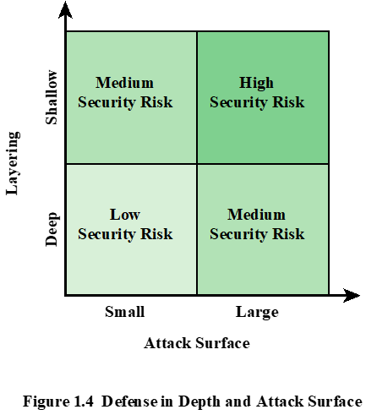
Security Risk
Defense in depth is a concept used in information security in which multiple layers of security controls (defense) are placed throughout the system.
Security risk can be determined by defense in depth layering (shallow or deep) and attack Surface (small or large).
Notes:
As illustrated in Figure 1.3, the use of layering, or defense in depth, and attack
surface reduction complement each other in mitigating security risk.

Slide 11
Terminology
Plaintext
Also called cleartext
Ciphertext
Scrambled message produced as output
Encryption algorithm
Transforms plaintext to ciphertext
Decryption algorithm
Transforms ciphertext to plaintext
Notes:
Public and private key
Pair of keys, one for encryption, one for decryption
Decryption key
Produces the original plaintext

Slide 12
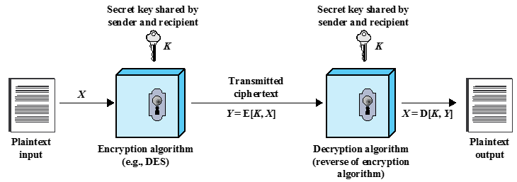
Symmetric Encryption
Encrypted_Message = Encrypt(Key, Message)
Message = Decrypt(Key, Encrypted_Message)
Also called secret-key cryptography, for protecting confidentiality
Sender and receiver must share the same secret key
Notes:
Concept: Secret Key Encryption
Method: Block Encryption
Improvement: Cipher Block Chaining (CBC)
Standards: DES, 3DES, AES
Need a strong encryption algorithm
The universal technique for providing confidentiality for transmitted or stored
data is symmetric encryption.
This section introduces the basic concept of symmetric encryption. This is followed by an overview of the two most important symmetric encryption algorithms: the Data Encryption Standard (DES) and the Advanced Encryption Standard (AES), which are block encryption algorithms. Finally, this section introduces the concept of symmetric stream encryption algorithms.
Symmetric encryption, also referred to as conventional encryption or single-key
encryption, was the only type of encryption in use prior to the introduction of public-key
encryption in the late 1970s. Countless individuals and groups, from Julius Caesar to the
German U-boat force to present-day diplomatic, military, and commercial users, have
used symmetric encryption for secret communication. It remains the more widely used
of the two types of encryption.
There are two requirements for secure use of symmetric encryption:
1. We need a strong encryption algorithm. At a minimum, we would like the
algorithm to be such that an opponent who knows the algorithm and has
access to one or more ciphertexts would be unable to decipher the ciphertext
or figure out the key. This requirement is usually stated in a stronger form:
The opponent should be unable to decrypt ciphertext or discover the key even
if he or she is in possession of a number of ciphertexts together with the plaintext
that produced each ciphertext.
2. Sender and receiver must have obtained copies of the secret key in a secure
fashion and must keep the key secure. If someone can discover the key and
knows the algorithm, all communication using this key is readable.

Slide 13
Attacking Symmetric Encryption
Cryptanalytic Attacks
Exploits the characteristics of the algorithm to attempt to recover plaintext or secret key
Rely on:
Nature of the algorithm
Some sample plaintext-ciphertext pairs
Some knowledge of the general characteristics of the plaintext, e.g., letter “e” and word “the” are common in English texts
Brute-Force Attacks
Try all possible keys on some ciphertext until an intelligible plaintext is obtained
Notes:
There are two general approaches to attacking a symmetric encryption
scheme. The first attack is known as cryptanalysis. Cryptanalytic attacks rely on
the nature of the algorithm plus perhaps some knowledge of the general characteristics
of the plaintext or even some sample plaintext-ciphertext pairs. This type of
attack exploits the characteristics of the algorithm to attempt to deduce a specific
plaintext or to deduce the key being used. If the attack succeeds in deducing the
key, the effect is catastrophic: All future and past messages encrypted with that key
are compromised.
The second method, known as the brute-force attack, is to try every possible
key on a piece of ciphertext until an intelligible translation into plaintext is obtained.
On average, half of all possible keys must be tried to achieve success.

Slide 14
Symmetric Encryption Simple Algorithm: Substitution-based
Substitution: Substituting one thing for another
Monoalphabetic: substitute one letter for another
plaintext: abcdefghijklmnopqrstuvwxyz
ciphertext: mnbvcxzasdfghjklpoiuytrewq
E.g.:
Plaintext: bob. i love you. alice ciphertext: nkn. s gktc wky. mgsbc
Polyalphabetic: Use multiple substitutions C1, C2, … The substitution selected depends upon the position.
⇒ The same letter coded differently in different positions.

Slide 15
Block & Stream Ciphers
Stream Cipher
Processes the input elements continuously, producing output one element at a time
One element may be 1 bit, 1 Byte, or more than 1 Byte
Faster than block ciphers
Block Cipher
Processes input data one block at a time
Produces an output block for each input block
We focus on block cipher in this lecture
Notes:
A block cipher processes the input one block of elements at a time, producing an
output block for each input block. A stream cipher processes the input elements
continuously, producing output one element at a time, as it goes along. Although
block ciphers are far more common, there are certain applications in which a stream
cipher is more appropriate. Examples are given subsequently in this book.
A typical stream cipher encrypts plaintext one byte at a time, although a stream
cipher may be designed to operate on one bit at a time or on units larger than a byte
at a time.
With a properly designed pseudorandom number generator, a stream cipher
can be as secure as block cipher of comparable key length. The primary advantage
of a stream cipher is that stream ciphers are almost always faster and use far less
code than do block ciphers. The advantage of a block cipher is that you can reuse
keys. For applications that require encryption/decryption of a stream of data, such as
over a data communications channel or a browser/Web link, a stream cipher might
be the better alternative. For applications that deal with blocks of data, such as file
transfer, e-mail, and database, block ciphers may be more appropriate. However,
either type of cipher can be used in virtually any application.
Pseudorandom stream is unpredictable without knowledge of the input key

Slide 16
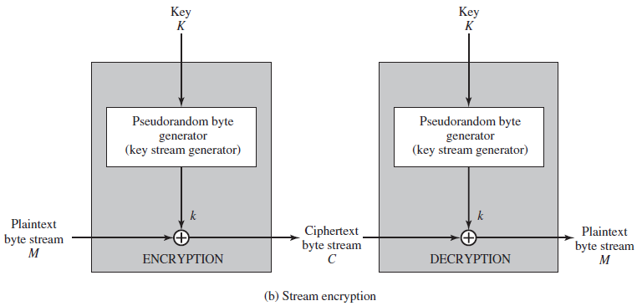
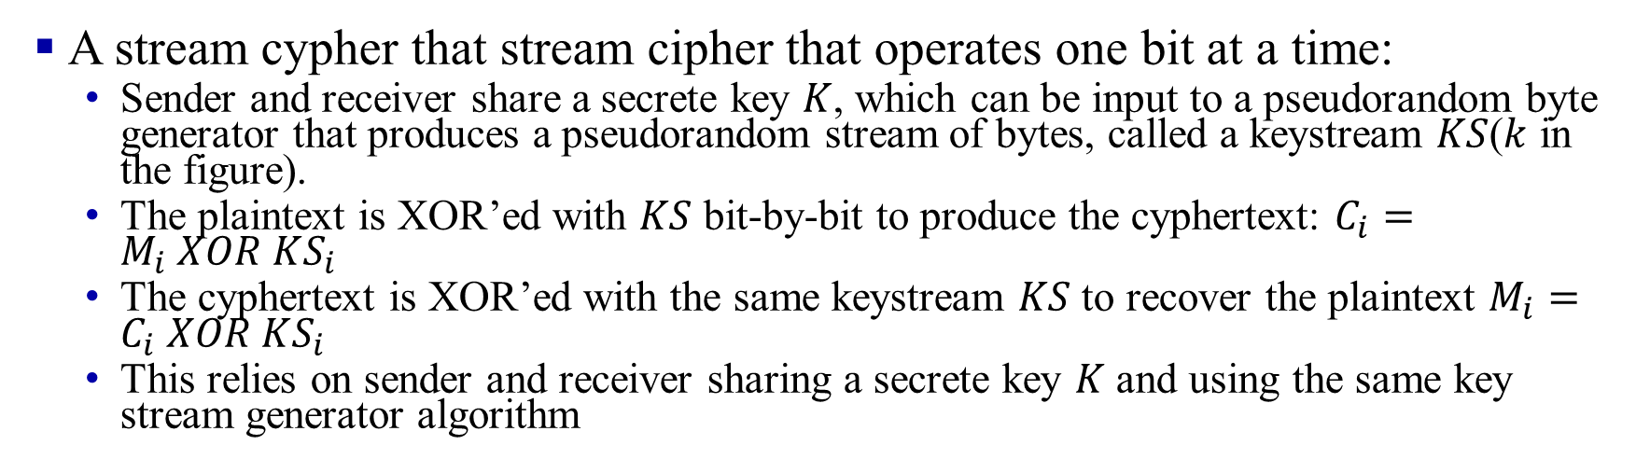
An Example Stream Cypher
A stream cypher that stream cipher that operates one bit at a time:
Sender and receiver share a secrete key $K$, which can be input to a pseudorandom byte generator that produces a pseudorandom stream of bytes, called a keystream $KS$($k$ in the figure).
The plaintext is XOR’ed with $KS$ bit-by-bit to produce the cyphertext: $C_{i}=M_{i} XOR KS_{i}$
The cyphertext is XOR’ed with the same keystream $KS$ to recover the plaintext $M_{i}=C_{i} XOR KS_{i}$
This relies on sender and receiver sharing a secrete key $K$ and using the same key stream generator algorithm
Notes:
Typically, symmetric encryption is applied to a
unit of data larger than a single 64-bit or 128-bit block. E-mail messages, network
packets, database records, and other plaintext sources must be broken up into a
series of fixed-length block for encryption by a symmetric block cipher. The simplest
approach to multiple-block encryption is known as electronic codebook (ECB)
mode, in which plaintext is handled b bits at a time and each block of plaintext is
encrypted using the same key. Typically b =64 or b =128
For lengthy messages, the ECB mode may not be secure. A cryptanalyst may
be able to exploit regularities in the plaintext to ease the task of decryption. For
example, if it is known that the message always starts out with certain predefined
fields, then the cryptanalyst may have a number of known plaintext-ciphertext pairs
to work with.
To increase the security of symmetric block encryption for large sequences
of data, a number of alternative techniques have been developed, called modes of
operation. These modes overcome the weaknesses of ECB; each mode has its own
particular advantages. This topic is explored in Chapter 20. Figure 2.2a shows the
ECB mode. A plaintext of length nb is divided into n b-bit blocks (P₁, P₂,….,P_{n}).
Each block is encrypted using the same algorithm and the same encryption key, to
produce a sequence of n b-bit blocks of ciphertext (C₁, C₂,….,C_{n}).
Figure 2.2b is a representative diagram of stream cipher structure. In this
structure a key is input to a pseudorandom bit generator that produces a stream
of 8-bit numbers that are apparently random. A pseudorandom stream is one that
is unpredictable without knowledge of the input key and which has an apparently
random character (see Section 2.5). The output of the generator, called a keystream,
is combined one byte at a time with the plaintext stream using the bitwise exclusive-
OR (XOR) operation.
is combined one byte at a time with the plaintext stream using the bitwise exclusive-
OR (XOR) operation.
A pseudo-random keystream XOR’ed with plaintext bit-by-bit:

Slide 17
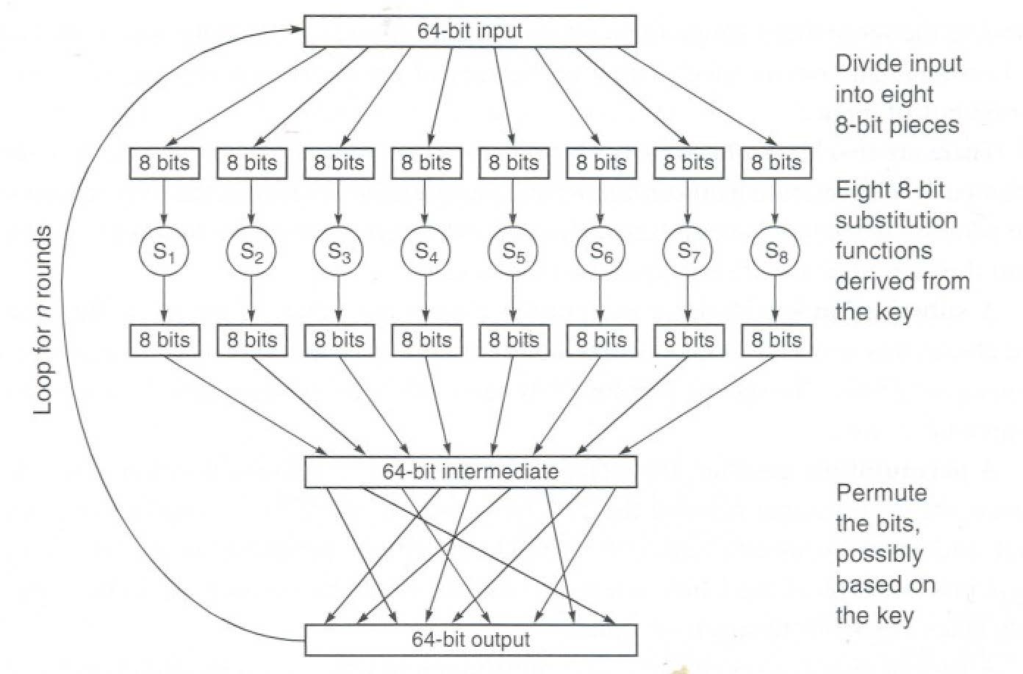
Block Encryption
Block Encryption for each block
Block
Substitution
Using a table
Permutation
Round

Slide 18
Block Encryption (Cont)
64-bit block
Short block length ⇒ tabular attack
Transformations:
Substitution: replace k-bit input blocks with k-bit output blocks
Permutation: move input bits around. 1 → 13, 2 → 61, etc.
Round: Substitution round followed by permutation round to achieve Diffusion + Confusion.
Diffusion ⇒ 1-bit change in input changes many bits in the output.
Confusion ⇒ Relationship between input and output is complex.

Slide 19
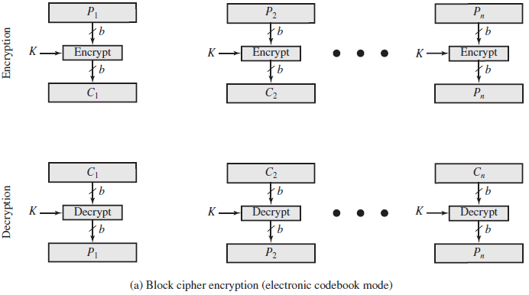

Block Cipher: Electronic CodeBook (ECB)
Each plaintext block $P_{i}$ (e.g., 64 or 128 bits) is encoded independently using the same key $K$
Attacker may exploit regularities in the plaintext to perform cryptoanalysis, since same plaintext block generates same cyphertext block.
Notes:
Typically, symmetric encryption is applied to a
unit of data larger than a single 64-bit or 128-bit block. E-mail messages, network
packets, database records, and other plaintext sources must be broken up into a
series of fixed-length block for encryption by a symmetric block cipher. The simplest
approach to multiple-block encryption is known as electronic codebook (ECB)
mode, in which plaintext is handled b bits at a time and each block of plaintext is
encrypted using the same key. Typically b =64 or b =128
For lengthy messages, the ECB mode may not be secure. A cryptanalyst may
be able to exploit regularities in the plaintext to ease the task of decryption. For
example, if it is known that the message always starts out with certain predefined
fields, then the cryptanalyst may have a number of known plaintext-ciphertext pairs
to work with.
To increase the security of symmetric block encryption for large sequences
of data, a number of alternative techniques have been developed, called modes of
operation. These modes overcome the weaknesses of ECB; each mode has its own
particular advantages. This topic is explored in Chapter 20. Figure 2.2a shows the
ECB mode. A plaintext of length nb is divided into n b-bit blocks (P₁, P₂,….,P_{n}).
Each block is encrypted using the same algorithm and the same encryption key, to
produce a sequence of n b-bit blocks of ciphertext (C₁, C₂,….,C_{n}).
Attacker may reorder blocks of ciphertext, then each block will still decrypt successfully, but message content is altered.

Slide 20
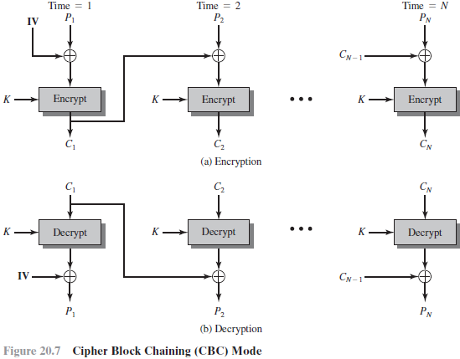
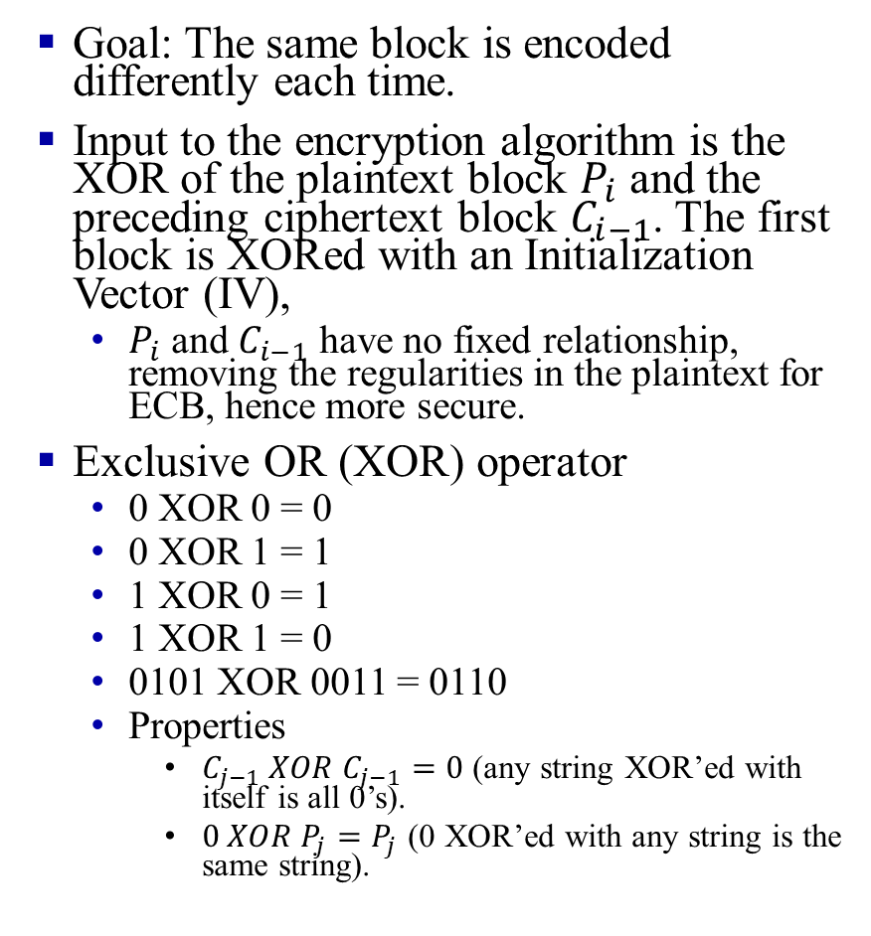
Block Cipher: Cipher Block Chaining (CBC)
Goal: The same block is encoded differently each time.
Input to the encryption algorithm is the XOR of the plaintext block $P_{i}$ and the preceding ciphertext block $C_{i−1}$. The first block is XORed with an Initialization Vector (IV),
$P_{i}$ and $C_{i−1}$ have no fixed relationship, removing the regularities in the plaintext for ECB, hence more secure.
Exclusive OR (XOR) operator
0 XOR 0 = 0
0 XOR 1 = 1
1 XOR 0 = 1
1 XOR 1 = 0
0101 XOR 0011 = 0110
Properties
$C_{j−1} XOR C_{j−1}=0$ (any string XOR’ed with itself is all 0’s).
$0 XOR P_{j}=P_{j}$ (0 XOR’ed with any string is the same string).
Notes:
to perform cryptoanalysis. Therefore, repeating patterns of b-bits are not exposed
Add a random number before encoding
In CBC mode, each plaintext block is XORed with the previous ciphertext block before being encrypted. The first block is XORed with an Initialization Vector (IV),
Need Initial Value (IV)
no IV ⇒ Same output for the same message
⇒ one can guess changed blocks.

Slide 21
Data Encryption Standard (DES)
Published by National Institute of Standards and Technology (NIST) in 1977
For commercial and unclassified government applications
Eight-octet (64-bit) key.
Efficient hardware implementation
Used in most financial transactions
Computing power goes up one bit every two years
56-bit was secure in 1977 but is not secure today
Notes:
Each octet with one odd parity bit ⇒ 56-bit key

Slide 22
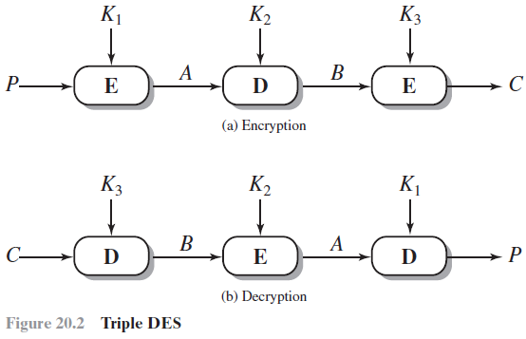
Triple DES (3DES)
Repeats DES three times using either 2 or 3 unique keys, with total key length of 112 or 168 bits
Ciphertext= DES(K1, DES(K2, DES(K1, Plain Text))) or
Ciphertext= DES(K3, DES(K2, DES(K1, Plain Text)))
Pros:
Key length of 112/168 bits removes the vulnerability to brute-force attacks
Cons:
Performance is slow: three times as many calculations as DES.
Block size larger than 64 bits is desirable for efficiency and security.
Notes:
The life of DES was extended by the use of triple DES (3DES),
which involves repeating the basic DES algorithm three times, using either two
or three unique keys, for a key size of 112 or 168 bits. Triple DES (3DES) was
first standardized for use in financial applications in ANSI standard X9.17 in 1985.
3DES was incorporated as part of the Data Encryption Standard in 1999, with the
publication of FIPS PUB 46-3.
3DES has two attractions that assure its widespread use over the next few
years. First, with its 168-bit key length, it overcomes the vulnerability to brute-force
attack of DES. Second, the underlying encryption algorithm in 3DES is the same as
in DES. This algorithm has been subjected to more scrutiny than any other encryption
algorithm over a longer period of time, and no effective cryptanalytic attack
based on the algorithm rather than brute force has been found. Accordingly, there
is a high level of confidence that 3DES is very resistant to cryptanalysis. If security
were the only consideration, then 3DES would be an appropriate choice for a standardized
encryption algorithm for decades to come.
The principal drawback of 3DES is that the algorithm is relatively sluggish in
software. The original DES was designed for mid-1970s hardware implementation
and does not produce efficient software code. 3DES, which requires three times as
many calculations as DES, is correspondingly slower. A secondary drawback is that
both DES and 3DES use a 64-bit block size. For reasons of both efficiency and security,
a larger block size is desirable.

Slide 23
Advanced Encryption Standard (AES)
Designed in 1997-2001 by National Institute of Standards and Technology (NIST) as Federal information processing standard (FIPS 197)
A symmetric block cipher with a block length of 128 bits
Key lengths 128, 192, and 256 bits.
Notes:
The entire key is used-no parity bit in the byte. The memory may use 9 bits to store a byte.

Slide 24
Time Required for Brute-Force Attack
Notes:
Table 2.2 shows how much time is required for
a brute-force attack for various key sizes. As can be seen, a single PC can break
DES in about a year; if multiple PCs work in parallel, the time is drastically shortened.
And today’s supercomputers should be able to find a key in about an hour.
Key sizes of 128 bits or greater are effectively unbreakable using simply a brute-force
approach. Even if we managed to speed up the attacking system by a factor
of 1 trillion (10¹² ), it would still take over 100,000 years to break a code using a
128-bit key.

Slide 25
Symmetric Key Encryption: Summary
Secret key encryption requires a shared secret key
Block encryption, e.g., DES, 3DES, AES, break cleartext into fixed-size blocks and encrypt
CBC ensures that the same plain text results in different ciphertexts.

Slide 26
Quiz
[6 points] Consider the 3-bit block cipher in the Table below
Plain | 000 | 001 | 010 | 011 | 100 | 101 | 110 | 111
Cipher | 110 | 111 | 101 | 100 | 011 | 010 | 000 | 001
Suppose the plaintext is 100101100.
Initially assume that CBC is not used. What is the resulting ciphertext?
Suppose Trudy sniffs the ciphertext. Assuming she knows that a 3-bit block cipher without CBC is being employed (but doesn’t know the specific cipher), what can she surmise?
Now, suppose that CBC is used with IV-111. What is the resulting ciphertext?

Slide 27
Quiz ANS
Plain | 000 | 001 | 010 | 011 | 100 | 101 | 110 | 111
Cipher | 110 | 111 | 101 | 100 | 011 | 010 | 000 | 001
Initially assume that CBC is not used. What is the resulting ciphertext?
ANS: Ciphertext for plaintext 100101100 is 011010011, since 100 maps to 011, 101 maps to 010, 100 maps to 011
(b) Suppose Trudy sniffs the ciphertext. Assuming she knows that a 3-bit block cipher without CBC is being employed (but doesn’t know the specific cipher), what can she surmise?
ANS: Without CBC, each identical plaintext block will always map to the same ciphertext block. This makes it easier for Trudy to recognize patterns in repeated blocks of data. If Trudy intercepts enough ciphertexts, she could perform frequency analysis on the blocks. For example, if certain ciphertext blocks appear more frequently, she might guess that they correspond to more common plaintext blocks (like spaces or common letters in text). Or if it is known that the message always starts out with certain predefined fields, then the cryptanalyst may have a number of known plaintext-ciphertext pairs to work with.
(c) Now, suppose that CBC is used with IV=111. What is the resulting ciphertext?
ANS: With CBC and IV = 111, resulting ciphertext for plaintext 100101100 is 100111100. See next page.
Notes:
Let's break down the problem step by step based on the information provided in the table and the questions asked.
### Given:
- The 3-bit block cipher is represented as a mapping between plaintext and ciphertext:
$$
\begin{array}{|c|c|}
\hline
\text{Plaintext} & \text{Ciphertext} \\
\hline
000 & 110 \\
001 & 111 \\
010 & 101 \\
011 & 100 \\
100 & 011 \\
101 & 010 \\
110 & 000 \\
111 & 001 \\
\hline
\end{array}
$$
### (a) **Without CBC: What is the resulting ciphertext for the plaintext `100101100`?**
The plaintext `100101100` is a sequence of 9 bits, which we can divide into three 3-bit blocks:
- First block: `100`
- Second block: `101`
- Third block: `100`
Using the table provided, we can map each block of plaintext to its corresponding ciphertext:
- `100` maps to `011`
- `101` maps to `010`
- `100` maps to `011`
Thus, the resulting ciphertext is the concatenation of these three ciphertext blocks:
$$
\text{Ciphertext} = 011010011
$$
### (b) **What can Trudy surmise if she sniffs the ciphertext and knows a 3-bit block cipher without CBC is being used?**
If Trudy intercepts the ciphertext but does not know the specific cipher being used, she can infer certain things based on her knowledge of how block ciphers work:
1. **Block Size**: Since she knows it's a 3-bit block cipher, she can deduce that each group of 3 bits in the intercepted ciphertext corresponds to one block of plaintext.
2. **Frequency Analysis**: If Trudy intercepts enough ciphertexts, she could perform frequency analysis on the blocks. For example, if certain ciphertext blocks appear more frequently, she might guess that they correspond to more common plaintext blocks (like spaces or common letters in text).
3. **No CBC Weakness**: Without CBC (Cipher Block Chaining), each identical plaintext block will always map to the same ciphertext block. This makes it easier for Trudy to recognize patterns in repeated blocks of data.
However, without knowing the specific mapping between plaintext and ciphertext, Trudy cannot directly decrypt the message unless she somehow discovers or guesses this mapping.
### (c) **With CBC and IV = 111: What is the resulting ciphertext for the plaintext `100101100`?**
When CBC (Cipher Block Chaining) is used, each plaintext block is XORed with the previous ciphertext block (or with the Initialization Vector (IV) for the first block) before being encrypted.
1. **IV = 111**: The first step is to XOR the first plaintext block with the IV.
- First plaintext block: `100`
- IV: `111`
- XOR result: $$ 100 \oplus 111 = 011 $$
Now we encrypt this result (`011`) using our cipher table:
- `011` maps to `100`.
So, the first ciphertext block is `100`.
2. **Second Block**: Now we XOR the second plaintext block with the first ciphertext block:
- Second plaintext block: `101`
- First ciphertext block: `100`
- XOR result: $$ 101 \oplus 100 = 001 $$
Now we encrypt this result (`001`) using our cipher table:
- `001` maps to `111`.
So, the second ciphertext block is `111`.
3. **Third Block**: Finally, we XOR the third plaintext block with the second ciphertext block:
- Third plaintext block: `100`
- Second ciphertext block: `111`
- XOR result: $$ 100 \oplus 111 = 011 $$
Now we encrypt this result (`011`) using our cipher table:
- `011` maps to `100`.
So, the third ciphertext block is `100`.
Thus, when using CBC with IV = 111, the resulting ciphertext is:
$$
\text{Ciphertext} = 100111100
$$
### Final Answer Summary:
- **(a)** Without CBC, resulting ciphertext for plaintext `100101100`:
$$ \text{Ciphertext} = 011010011 $$
- **(b)** Trudy can infer that it's a 3-bit cipher and may use frequency analysis but cannot directly decrypt without knowing the specific mapping.
- **(c)** With CBC and IV = 111, resulting ciphertext for plaintext `100101100`:
$$ \text{Ciphertext} = 100111100 $$
Citations:
[1] https://ppl-ai-file-upload.s3.amazonaws.com/web/direct-files/657250/670d6e33-bf04-4786-8da4-9b8cff7bf69b/Temp.pdf

Slide 28
Quiz ANS cont
Plain | 000 | 001 | 010 | 011 | 100 | 101 | 110 | 111
Cipher | 110 | 111 | 101 | 100 | 011 | 010 | 000 | 001
The first step is to XOR the first plaintext block with IV = 111
First plaintext block: 100, so 100⊕111=011
Now we encrypt this result (011) using our cipher table: 011 maps to 100.
Second Block: Now we XOR the second plaintext block with the first ciphertext block:
Second plaintext block: 101, so 101⊕100=001
Now we encrypt this result (001) using our cipher table: 001 maps to 111.
Third Block: Finally, we XOR the third plaintext block with the second ciphertext block:
Third plaintext block: 100, so 100⊕111=011
Now we encrypt this result (011) using our cipher table: 011 maps to 100.
Resulting ciphertext for plaintext 100101100 is 100111100.

Slide 29
Public Key Crypto
Invented in 1975 by Diffie and Hellman
Based on modular arithmetic functions
Asymmetric: uses two separate keys
Encrypted_Message = Encrypt(Key1, Message)
Message = Decrypt(Key2, Encrypted_Message)
Key1
Text
Ciphertext
Key2
Ciphertext
Text

Slide 30


Public Key Crypto (Cont)
One key is private, and the other is public
Message=Decrypt(Public_Key, Encrypt(Private_Key, Message))
Message=Decrypt(Private_Key, Encrypt(Public_Key, Message))
Encrypted with public key, decrypted with private key
Encrypted with private key. decrypted with public key
Msg
Msg
Alice’s Public Key
Alice’s Private Key
Msg
Msg
Alice’s Private Key
Alice’s Public Key

Slide 31
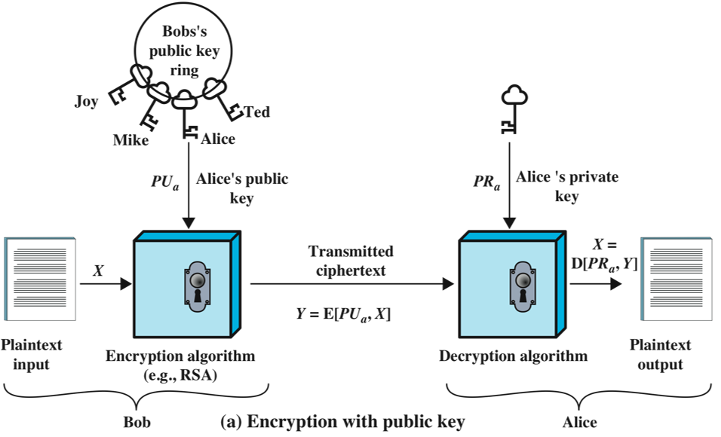
Public-Key Crypto for Confidentiality
Sender encrypts data using the receiver’s public key
Receiver decrypts data using his own private key
Use of a public/private key pair removes the need for sharing a secret key
Notes:
A public-key encryption scheme has six ingredients (Figure 2.6a):
• Plaintext: This is the readable message or data that is fed into the algorithm as
input.
• Encryption algorithm: The encryption algorithm performs various transformations
on the plaintext.
• Public and private key: This is a pair of keys that have been selected so that
if one is used for encryption, the other is used for decryption. The exact
transformations performed by the encryption algorithm depend on the public
or private key that is provided as input.
Ciphertext: This is the scrambled message produced as output. It depends on
the plaintext and the key. For a given message, two different keys will produce
two different ciphertexts.
• Decryption algorithm: This algorithm accepts the ciphertext and the matching
key and produces the original plaintext.
As the names suggest, the public key of the pair is made public for others to
use, while the private key is known only to its owner. A general-purpose public-key
cryptographic algorithm relies on one key for encryption and a different but related
key for decryption.
The essential steps are the following:
1. Each user generates a pair of keys to be used for the encryption and decryption
of messages.
2. Each user places one of the two keys in a public register or other accessible
file. This is the public key. The companion key is kept private. As Figure 2.6a
suggests, each user maintains a collection of public keys obtained from others.
3. If Bob wishes to send a private message to Alice, Bob encrypts the message
using Alice’s public key.
4. When Alice receives the message, she decrypts it using her private key. No
other recipient can decrypt the message because only Alice knows Alice’s private
key.
With this approach, all participants have access to public keys, and private keys
are generated locally by each participant and therefore need never be distributed.
As long as a user protects his or her private key, incoming communication is secure.
At any time, a user can change the private key and publish the companion public
key to replace the old public key.
Note that the scheme of Figure 2.6a is directed toward providing confidentiality:
Only the intended recipient should be able to decrypt the ciphertext because only
the intended recipient is in possession of the required private key. Whether in fact
confidentiality is provided depends on a number of factors, including the security of
the algorithm, whether the private key is kept secure, and the security of any protocol
of which the encryption function is a part.

Slide 32
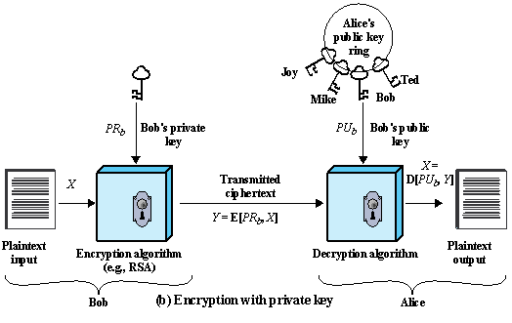


Public-Key Crypto for Integrity and Non-Repudiation
Sender encrypts data using his or her private key
Receiver, or anyone else, can decrypt the message using sender’s public key.
There are more efficient methods based on MAC or crypto hash function (discussed later).
My Private Key
Message
Your Public Key
Notes:
Figure 2.6b illustrates another mode of operation of public-key cryptography.
In this scheme, a user encrypts data using his or her own private key.
Anyone who knows the corresponding public key will then be able to decrypt the
message.
The scheme of Figure 2.6b is directed toward providing authentication
and/or data integrity. If a user is able to successfully recover the plaintext from
Bob’s ciphertext using Bob’s public key, this indicates that only Bob could have
encrypted the plaintext, thus providing authentication. Further, no one but
Bob would be able to modify the plaintext because only Bob could encrypt the
plaintext with Bob’s private key. Once again, the actual provision of authentication
or data integrity depends on a variety of factors. This issue is addressed
primarily in Chapter 21, but other references are made to it where appropriate in
this text.

Slide 33
Public-Key Crypto for both Confidentiality and Integrity/Non-Repudiation
Combine the previous two approaches
Bob sends message to Alice
Bob performs: Encrypted_Message = Encrypt(Public_Key_Alice, Encrypt(Private_Key_Bob, Message))
Alice performs: Cleartext_Message = Decrypt(Public_Key_Bob, Decrypt(Private_Key_Alice, Encrypted_Message)
Private_Key_Bob
Message
Public_Key_Alice

Slide 34
Public-Key Crypto Algorithms and Protocols
RSA (Rivest-Shamir-Adelman)
Key generation, encryption, decryption
Elliptic Curve Cryptography (ECC)
Lightweight public key algorithm for embedded and IoT devices
Diffie-Hellman
Key exchange protocol used to establish a shared secret between two parties, e.g., a secret key for symmetric encryption
Notes:
Before proceeding, we need to clarify one aspect of public-key cryptosystems that is
otherwise likely to lead to confusion. Public-key systems are characterized by the use
of a cryptographic type of algorithm with two keys, one held private and one available
publicly. Depending on the application, the sender uses either the sender’s private key
or the receiver’s public key, or both, to perform some type of cryptographic function.
In broad terms, we can classify the use of public-key cryptosystems into three categories:
digital signature, symmetric key distribution, and encryption of secret keys.
These applications are discussed in Section 2.4. Some algorithms are suitable
for all three applications, whereas others can be used only for one or two of
these applications. Table 2.3 indicates the applications supported by the algorithms
discussed
in this section. (DSS: Digital Signature Standard)

Slide 35
Background: Modular Arithmetic
xy mod m = (x mod m) (y mod m) mod m
x⁴ mod m = (x² mod m)(x² mod m) mod m
x^{ij} mod m = (x^{i} mod m)^{j} mod m
125 mod 187 = 125
125² mod 187 = 15625 mod 187 = 104
125 mod 187 = (125 mod 187) mod 187
= 104² mod 187 = 10816 mod 187 = 157
Notation:
x = y mod z or
x = y (mod z) or
x mod z = y
4 2 2
125 mod 187 = 157 mod 187 = 152
125 mod 187 = 152 mod 187 = 103
125³² mod 187 = 103² mod 187 = 137
125⁶⁴ mod 187 = 137² mod 187 = 69
₁₂₅107₌ ₁₂₅64+32+8+2+1 _{mod 187}
= 69×137×152×104×125 mod 187
= 18679128000 mod 187 = 5
8 2
16 2
Notes:
You need to be able to do additions to convert 107 to 64+32+8+2+1

Slide 36
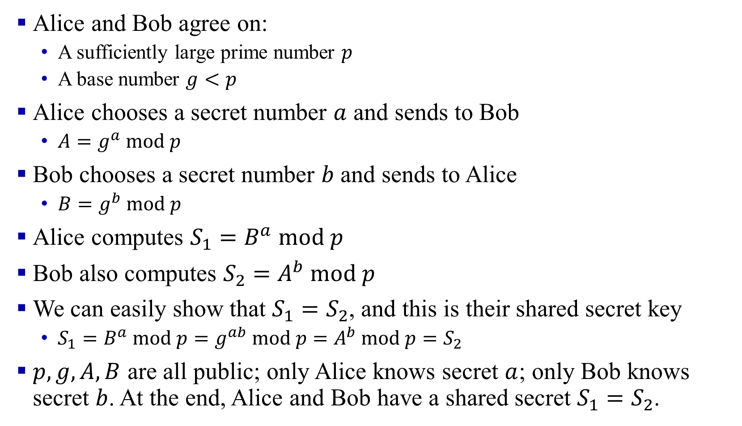
Diffie-Hellman
Alice and Bob agree on:
A sufficiently large prime number $p$
A base number $g<p$
Alice chooses a secret number $a$ and sends to Bob
$A=g^{a} mod p$
Bob chooses a secret number $b$ and sends to Alice
$B=g^{b} mod p$
Alice computes $S_{1}=B^{a} mod p$
Bob also computes $S_{2}=A^{b} mod p$
We can easily show that $S_{1}=S_{2}$, and this is their shared secret key
$S_{1}=B^{a} mod p=g^{ab} mod p=A^{b} mod p=S_{2}$
$p,g,A,B$ are all public; only Alice knows secret $a$; only Bob knows secret $b$. At the end, Alice and Bob have a shared secret $S_{1}=S_{2}$.
Notes:
Public Key Generation
$A,B,p,g$ are all public; only $A$ knows secret $a$; only $B$ knows secret $b$.

Slide 37
Requirements for Public-Key Crypto
Computationally easy to
create key pairs
encrypt/decrypt messages using either public or private key
Computationally infeasible to
determine private key from public key
recover cleartext without key
Either key can be used for each role (public/private key)
Notes:
The cryptosystem illustrated in Figure 2.6 depends on a cryptographic algorithm
based on two related keys. Diffie and Hellman postulated this system without demonstrating
that such algorithms exist. However, they did lay out the conditions that
such algorithms must fulfill [DIFF76]:
RSA (Rivest, Shamir, Adleman)
Developed in 1977
Most widely accepted and implemented approach to public-key encryption
Block cipher in which the plaintext and ciphertext are integers between 0 and n-1 for some n.
Diffie-Hellman key exchange algorithm
Enables two users to securely reach agreement about a shared secret that can be used as a secret key for subsequent symmetric encryption of messages
Limited to the exchange of the keys
Digital Signature Standard (DSS)
Provides only a digital signature function with SHA-1
Cannot be used for encryption or key exchange
Elliptic curve cryptography (ECC)
Security like RSA, but with much smaller keys

Slide 38
Public Key Crypto: Summary
Public Key Encryption uses two keys: Public and Private.
Either key can be used to encrypt. The other key will decrypt.
Notes:
RSA public key method is based on the difficulty of factorization.
Consider RSA with p=7, q=17
what are n and z
let e be 5. Why is this an acceptable choice for e?
Find d such that de=1(mod z)
Encrypt the message m=25 using the public key (n, e). Let c be the corresponding ciphertext.
What is the private key. Verify that we can get the original message using the private key. Show all work.

Slide 39
Message Authentication
Verifies received message is authentic, i.e., Contents unchanged + Source Verified
Its content has not been altered (authentic content), and it is from the alleged sender (authentic source)
Can use encryption (symmetric or public-key)
Sender encrypts the message, receiver decrypts it
But computationally inefficient for large messages
Notes:
Encryption protects against passive attack (eavesdropping). A different requirement
is to protect against active attack (falsification of data and transactions). Protection
against such attacks is known as message or data authentication.
A message, file, document, or other collection of data is said to be authentic
when it is genuine and came from its alleged source. Message or data authentication
is a procedure that allows communicating parties to verify that received or stored
messages are authentic. The two important aspects are to verify that the contents of
the message have not been altered and that the source is authentic. We may also wish
to verify a message’s timeliness (it has not been artificially delayed and replayed)
and sequence relative to other messages flowing between two parties. All of these
concerns come under the category of data integrity as described in Chapter 1.
It would seem possible to perform authentication simply by the use of symmetric
encryption. If we assume that only the sender and receiver share a key (which is
as it should be), then only the genuine sender would be able to encrypt a message
successfully for the other participant, provided the receiver can recognize a valid message.
Furthermore, if the message includes an error-detection code and a sequence
number, the receiver is assured that no alterations have been made and that sequencing
is proper. If the message also includes a timestamp, the receiver is assured that the
message has not been delayed beyond that normally expected for network transit.
In fact, symmetric encryption alone is not a suitable tool for data authentication.
To give one simple example, in the ECB mode of encryption, if an attacker
reorders the blocks of ciphertext, then each block will still decrypt successfully.
However, the reordering may alter the meaning of the overall data sequence.
Although sequence numbers may be used at some level (e.g., each IP packet), it is
typically not the case that a separate sequence number will be associated with each
b-bit block of plaintext. Thus, block reordering is a threat.

Slide 40
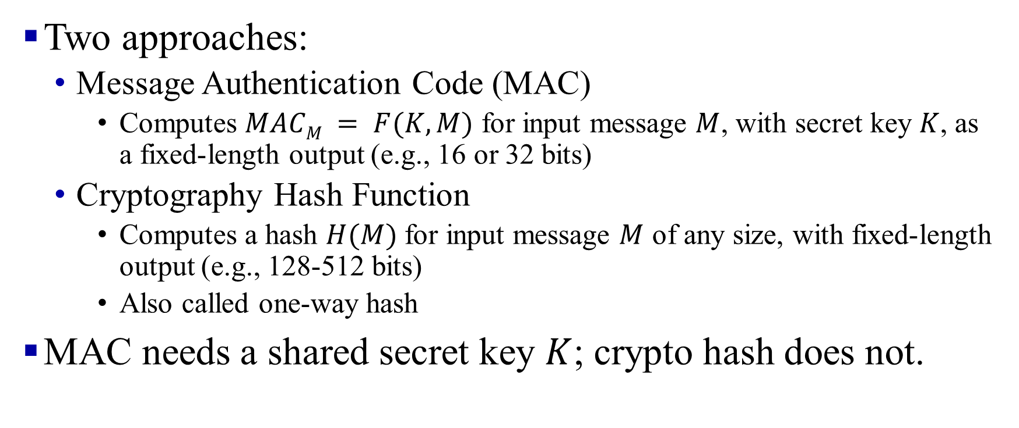
Message Authentication without Encryption
Two approaches:
Message Authentication Code (MAC)
Computes $MACM = F(K, M)$ for input message $M$, with secret key $K$, as a fixed-length output (e.g., 16 or 32 bits)
Cryptography Hash Function
Computes a hash $H(M)$ for input message $M$ of any size, with fixed-length output (e.g., 128-512 bits)
Also called one-way hash
MAC needs a shared secret key $K$; crypto hash does not.

Slide 41
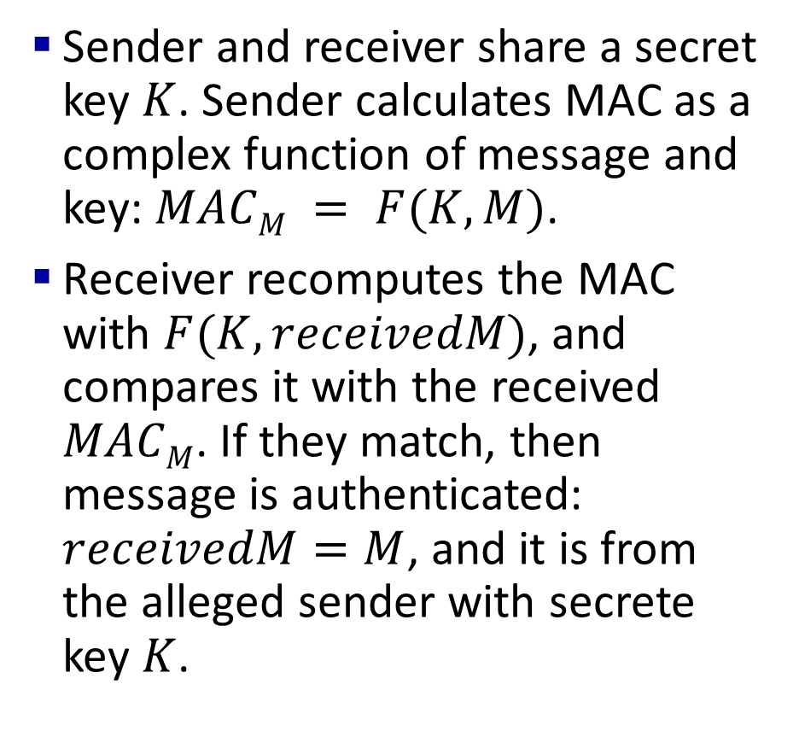
Message Authentication Code (MAC)
Sender and receiver share a secret key $K$. Sender calculates MAC as a complex function of message and key: $MACM = F(K, M)$.
Receiver recomputes the MAC with $F(K, receivedM)$, and compares it with the received $MACM$. If they match, then message is authenticated: $receivedM=M$, and it is from the alleged sender with secrete key $K$.
Notes:
Authentic Message = Contents unchanged + Source Verified
May also want to ensure that the time of the message is correct
Encrypt_{secret key}{Message, CRC, Time Stamp}
Message + Encrypt_{secret key}(Hash)
Or, Message + Encrypt_{Source’s private key}(Hash)
7
One authentication technique involves
the use of a secret key to generate a small block of data, known as a message
authentication code, that is appended to the message. This technique assumes that
two communicating parties, say A and B, share a common secret key K_{AB}. When
A has a message to send to B, it calculates the message authentication code as a
complex function of the message and the key: MAC_{M} F(K_{AB}, M). The message
plus code are transmitted to the intended recipient. The recipient performs the same
calculation on the received message, using the same secret key, to generate a new
message authentication code. The received code is compared to the calculated code
(Figure 2.3). If we assume that only the receiver and the sender know the identity of
the secret key, and if the received code matches the calculated code, then
1. The receiver is assured that the message has not been altered. If an attacker
alters the message but does not alter the code, then the receiver’s calculation
of the code will differ from the received code. Because the attacker is assumed
not to know the secret key, the attacker cannot alter the code to correspond to
the alterations in the message.
2. The receiver is assured that the message is from the alleged sender. Because
no one else knows the secret key, no one else could prepare a message with a
proper code.
3. If the message includes a sequence number (such as is used with X.25, HDLC,
and TCP), then the receiver can be assured of the proper sequence, because
an attacker cannot successfully alter the sequence number.
A number of algorithms could be used to generate the code. The NIST specification,
FIPS PUB 113, recommends the use of DES. DES is used to generate an
encrypted version of the message, and the last number of bits of ciphertext are used
as the code. A 16- or 32-bit code is typical.
The process just described is similar to encryption. One difference is that the
authentication algorithm need not be reversible, as it must for decryption. It turns
out that because of the mathematical properties of the authentication function, it is
less vulnerable to being broken than encryption.

Slide 42
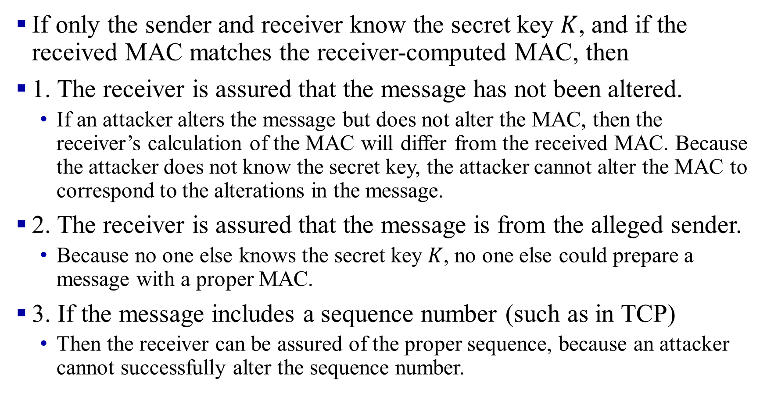
MAC Explanations
If only the sender and receiver know the secret key $K$, and if the received MAC matches the receiver-computed MAC, then
1. The receiver is assured that the message has not been altered.
If an attacker alters the message but does not alter the MAC, then the receiver’s calculation of the MAC will differ from the received MAC. Because the attacker does not know the secret key, the attacker cannot alter the MAC to correspond to the alterations in the message.
2. The receiver is assured that the message is from the alleged sender.
Because no one else knows the secret key $K$, no one else could prepare a message with a proper MAC.
3. If the message includes a sequence number (such as in TCP)
Then the receiver can be assured of the proper sequence, because an attacker cannot successfully alter the sequence number.
Notes:
Keyed Hash ⇒ includes a key along with the message
HMAC is a general design. Can use any hash function
⇒ HMAC-MD5, HMAC-AES
Uses hash functions without modifications
Has a well-understood cryptographic analysis of authentication mechanism strength
HMAC Overview

Slide 43
Hash Functions
12345678901234567
Hash
12345678901234767
Hash
Example: CRC can be used as a hash
(not recommended for security applications)
Requirements:
Applicable to any size message
Fixed length output
Easy to compute
Difficult to Invert ⇒ Can’t find x given H(x) ⇒ One-way
Difficult to find y, such that H(x) = H(y) ⇒ Can’t change msg
Difficult to find any pair (x, y) such that H(x) = H(y)
⇒ Strong hash

Slide 44
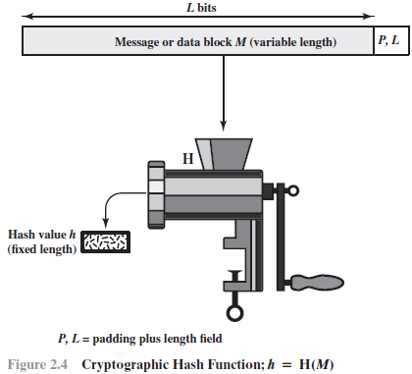
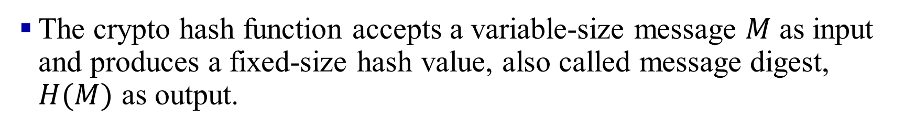
Crypto Hash Function
The crypto hash function accepts a variable-size message $M$ as input and produces a fixed-size hash value, also called message digest, $H(M)$ as output.

Slide 45
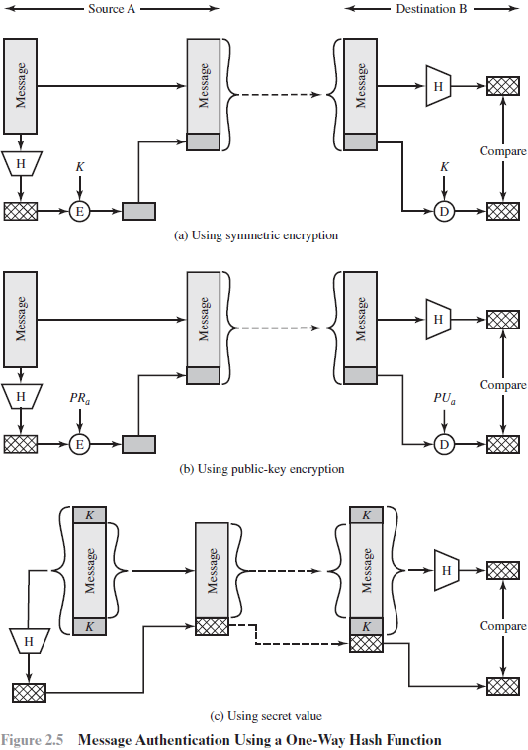
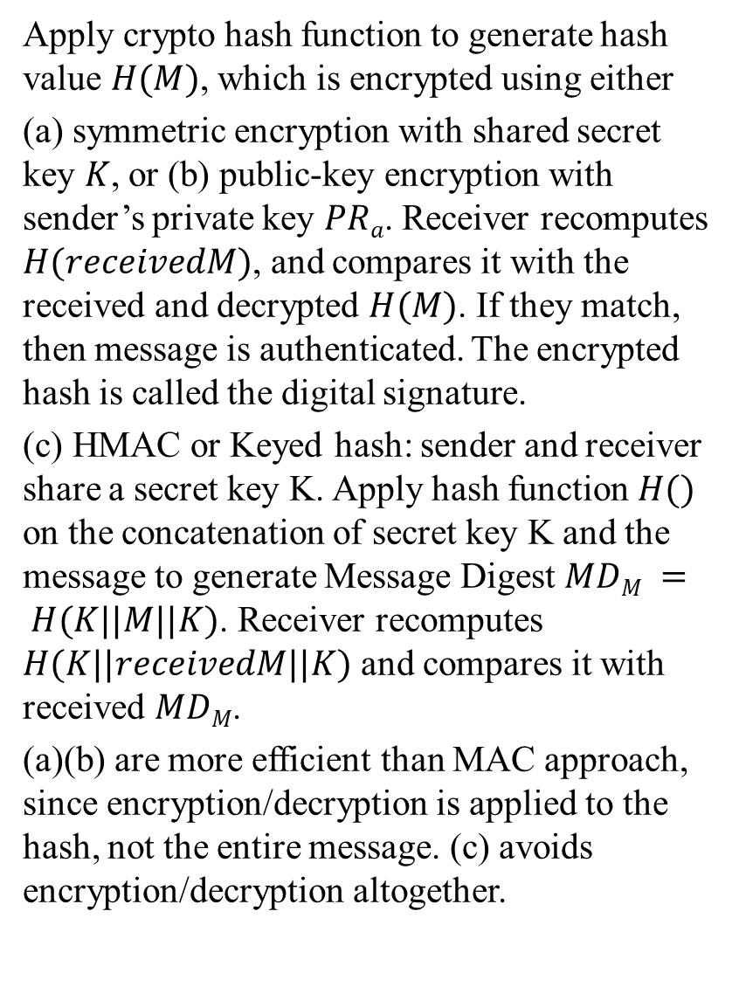
Apply crypto hash function to generate hash value $H(M)$, which is encrypted using either
(a) symmetric encryption with shared secret key $K$, or (b) public-key encryption with sender’s private key $PRa$. Receiver recomputes $H(receivedM)$, and compares it with the received and decrypted $H(M)$. If they match, then message is authenticated. The encrypted hash is called the digital signature.
(c) HMAC or Keyed hash: sender and receiver share a secret key K. Apply hash function $H()$ on the concatenation of secret key K and the message to generate Message Digest $MDM = H(K||M||K)$. Receiver recomputes $H(K||receivedM||K)$ and compares it with received $MDM$.
(a)(b) are more efficient than MAC approach, since encryption/decryption is applied to the hash, not the entire message. (c) avoids encryption/decryption altogether.
Notes:
It is efficient since no encryption/decryption is used.
Message Digest = Hash(Message)
Signature = Encrypt(Private_Key, Hash)
Hash(Message) = Decrypt(Public_Key, Signature)
⇒ Authentic
Private Key

Slide 46
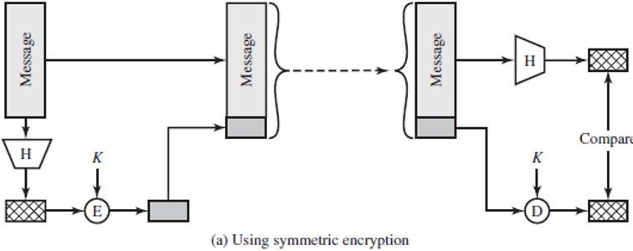
Crypto Hash Algorithms: MD5 & SHA-1
Based on symmetric encryption
MD5 Hash
128-bit hash using 512-bit blocks using 32-bit operations
SHA-1 Algorithm
160-bit hash using 512-bit blocks and 32-bit operations
Both have been found to be vulnerable to attacks and is no longer recommended for secure applications
Notes:
The maximum message size is 2⁶⁴ bit
Five passes (compared to 4 in MD5 and 3 in MD4)
Invented by Ron Rivest in 1991, and Described in RFC 1321
Commonly used to check the integrity of files
Also used to store passwords
(easy to fudge message and the checksum)
Hash Functions
MD5 Hash
SHA-1 Algorithm
Message Authentication Code (MAC)
Digital Signature
Digital Certificates
End Point Authentication

Slide 47
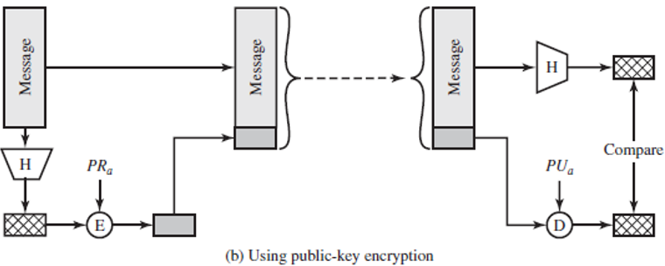
Digital signature
Based on public-key encryption
A digital signature is a cryptographic technique used to verify the authenticity and integrity of a digital message or document. It serves a similar purpose to a handwritten signature or a stamped seal, but it provides far more security due to its cryptographic foundations.
Private Key
Text ^{Hash} Digest
Signature
Public Key
Signature
Digest ^{Hash}
Text

Slide 48
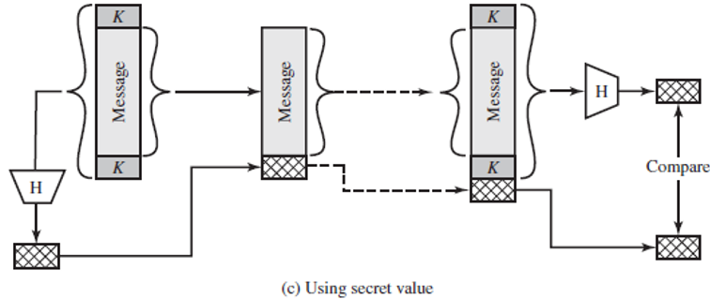
HMAC
HMAC (Hash-based Message Authentication Code) is a keyed cryptographic hash function used to ensure both the integrity and authenticity of a message. It combines a cryptographic hash function (like MD5, SHA-1, or SHA-256) with a secret key. The result is a hash that can only be generated or verified by someone who knows the secret key.
HMAC is a general design. Can use any hash function ⇒ HMAC-MD5, HMAC-AES.
Notes:
Keyed Hash: includes a key along with message
Has well understood cryptographic analysis of authentication mechanism strength

Slide 49
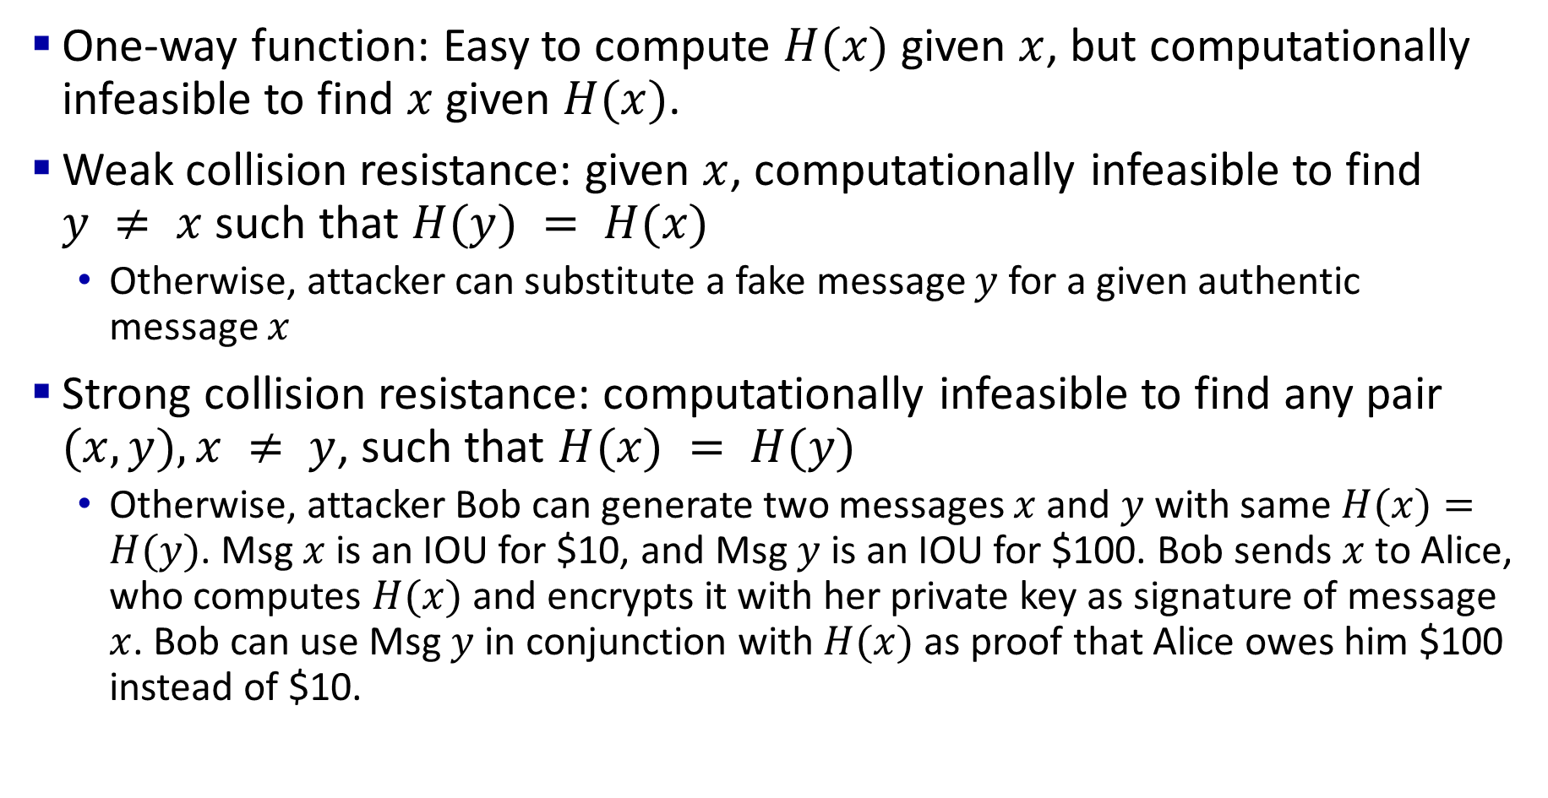
Crypto Hash Function Requirements
One-way function: Easy to compute $H(x)$ given $x$, but computationally infeasible to find $x$ given $H(x)$.
Weak collision resistance: given $x$, computationally infeasible to find $y ≠ x$ such that $H(y) = H(x)$
Otherwise, attacker can substitute a fake message $y$ for a given authentic message $x$
Strong collision resistance: computationally infeasible to find any pair $(x,y), x ≠ y$, such that $H(x) = H(y)$
Otherwise, attacker Bob can generate two messages $x$ and $y$ with same $H(x)=H(y)$. Msg $x$ is an IOU for $10, and Msg $y$ is an IOU for $100. Bob sends $x$ to Alice, who computes $H(x)$ and encrypts it with her private key as signature of message $x$. Bob can use Msg $y$ in conjunction with $H(x)$ as proof that Alice owes him $100 instead of $10.
Notes:
An alternative to the message authentication code is the
one-way hash function. As with the message authentication code, a hash function
accepts a variable-size message M as input and produces a fixed-size message digest
H(M) as output (Figure 2.4). Typically, the message is padded out to an integer multiple
of some fixed length (e.g., 1024 bits) and the padding includes the value of the length
of the original message in bits. The length field is a security measure to increase the
difficulty for an attacker to produce an alternative message with the same hash value.
Unlike the MAC, a hash function does not also take a secret key as input.
To authenticate a message, the message digest is sent with the message in such
a way that the message digest is authentic. Figure 2.5 illustrates three ways in
which the message can be authenticated using a hash code. The message digest
can be encrypted using symmetric encryption (part a); if it is assumed that only
the sender and receiver share the encryption key, then authenticity is assured. The
message digest can also be encrypted using public-key encryption (part b); this is
explained in Section 2.3. The public-key approach has two advantages: It provides
a digital signature as well as message authentication; and it does not require the
distribution of keys to communicating parties.
These two approaches have an advantage over approaches that encrypt the
entire message in that less computation is required. But an even more common approach is
the use of a technique that avoids encryption altogether. Several reasons
for this interest are pointed out in [TSUD92]:
• Encryption software is quite slow. Even though the amount of data to be
encrypted per message is small, there may be a steady stream of messages into
and out of a system.
• Encryption hardware costs are non-negligible. Low-cost chip implementations
of DES are available, but the cost adds up if all nodes in a network must have
this capability.
• Encryption hardware is optimized toward large data sizes. For small blocks of
data, a high proportion of the time is spent in initialization/invocation overhead.
• An encryption algorithm may be protected by a patent.
Figure 2.5c shows a technique that uses a hash function but no encryption
for message authentication. This technique, known as a keyed hash MAC, assumes
that two communicating parties, say A and B, share a common secret key K.
This secret key is incorporated into the process of generating a hash code. In the
approach illustrated in Figure 2.5c, when A has a message to send to B, it calculates
the hash function over the concatenation of the secret key and the message:
MD_{M} = H(K ll M ll K). It then sends [ M ii MD_{M}] to B. Because B possesses K, it can
recompute H(K ll M ll K) and verify MD_{M}. Because the secret key itself is not sent, it
should not be possible for an attacker to modify an intercepted message. As long as
the secret key remains secret, it should not be possible for an attacker to generate a
false message.
Note that the secret key is used as both a prefix and a suffix to the message. If
the secret key is used as either only a prefix or only a suffix, the scheme is less secure.
This topic is discussed in Chapter 21. Chapter 21 also describes a scheme known
as HMAC, which is somewhat more complex than the approach of Figure 2.5c and
which has become the standard approach for a keyed hash MAC.

Slide 50
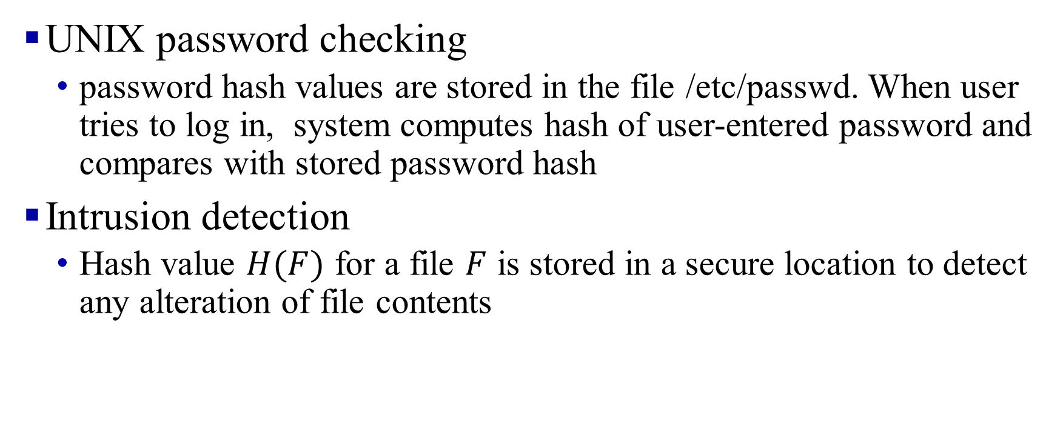
Additional Hash Function Applications
UNIX password checking
password hash values are stored in the file /etc/passwd. When user tries to log in, system computes hash of user-entered password and compares with stored password hash
Intrusion detection
Hash value $H(F)$ for a file $F$ is stored in a secure location to detect any alteration of file contents

Slide 51
Random Numbers
Used to generate:
Keys for public-key algorithms
Stream key for symmetric stream cipher
Symmetric key for use as a temporary session key or in creating a digital envelope
Handshaking to prevent replay attacks
Session key
Notes:
A number of network security algorithms based on cryptography make use of
random numbers. For example,
• Generation of keys for the RSA public-key encryption algorithm (described
in Chapter 21) and other public-key algorithms.
• Generation of a stream key for symmetric stream cipher.
• Generation of a symmetric key for use as a temporary session key or in creating
a digital envelope.
• In a number of key distribution scenarios, such as Kerberos (described in
Chapter 23), random numbers are used for handshaking to prevent replay
attacks.
• Session key generation, whether done by a key distribution center or by one of
the principals.
These applications give rise to two distinct and not necessarily compatible
requirements for a sequence of random numbers: randomness and unpredictability.

Slide 52
Random Number Requirements
Randomness
Uniform distribution
Frequency of occurrence of each of the numbers should be approximately the same
Independence
No one value in the sequence can be inferred from the others
Unpredictability
Each number is statistically independent of others in the sequence, so future elements of the sequence cannot be predicted based on past elements
Notes:
Traditionally, the concern in the generation of a sequence of
allegedly random numbers has been that the sequence of numbers be random in
some well-defined statistical sense. The following two criteria are used to validate
that a sequence of numbers is random:
• Uniform distribution: The distribution of numbers in the sequence should be
uniform; that is, the frequency of occurrence of each of the numbers should be
approximately the same.
• Independence: No one value in the sequence can be inferred from the others.
Although there are well-defined tests for determining that a sequence of numbers
matches a particular distribution, such as the uniform distribution, there is no such
test to “prove” independence. Rather, a number of tests can be applied to demonstrate
if a sequence does not exhibit independence. The general strategy is to apply a number
of such tests until the confidence that independence exists is sufficiently strong.
In the context of our discussion, the use of a sequence of numbers that appear
statistically random often occurs in the design of algorithms related to cryptography.
In essence, if a problem is too hard or time-consuming to solve exactly, a simpler, shorter approach
based on randomization is used to provide an answer with any desired level of
confidence.
UNPREDICTABILITY
In applications such as reciprocal authentication and session key
generation, the requirement is not so much that the sequence of numbers be statistically
random but that the successive members of the sequence are unpredictable. With
“true” random sequences, each number is statistically independent of other numbers
in the sequence and therefore unpredictable. However, as is discussed shortly, true
random numbers are not always used; rather, sequences of numbers that appear to
be random are generated by some algorithm. In this latter case, care must be taken
that an opponent not be able to predict future elements of the sequence on the basis
of earlier elements.

Slide 53
Pseudorandom vs. Random Numbers
Pseudorandom numbers are generated with deterministic algorithms with random seeds:
The same seed results in the same sequence of random numbers
The sequence produced are not truly statistically random, but may pass many reasonable tests of randomness
True random number generator (TRNG):
Uses a nondeterministic source to produce randomness
Most operate by measuring unpredictable natural processes
e.g. radiation, gas discharge, leaky capacitors
Notes:
Cryptographic applications typically make use of algorithmic techniques for random
number generation. These algorithms are deterministic and therefore produce
sequences of numbers that are not statistically random. However, if the algorithm is
good, the resulting sequences will pass many reasonable tests of randomness. Such
numbers are referred to as pseudorandom numbers.
You may be somewhat uneasy about the concept of using numbers generated
by a deterministic algorithm as if they were random numbers. Despite what might
be called philosophical objections to such a practice, it generally works. As one
expert on probability theory puts it [HAMM91],
For practical purposes we are forced to accept the awkward concept
of “relatively random” meaning that with regard to the proposed
use we can see no reason why they will not perform as if they were
random (as the theory usually requires). This is highly subjective
and is not very palatable to purists, but it is what statisticians regularly
appeal to when they take “a random sample”—they hope that
any results they use will have approximately the same properties as
a complete counting of the whole sample space that occurs in their
theory.
A true random number generator (TRNG) uses a nondeterministic source to
produce randomness. Most operate by measuring unpredictable natural processes,
such as pulse detectors of ionizing radiation events, gas discharge tubes, and leaky
capac itors. Intel has developed a commercially available chip that samples thermal
noise by amplifying the voltage measured across undriven resistors [JUN99].
A group at Bell Labs has developed a technique that uses the variations in the
response time of raw read requests for one disk sector of a hard disk [JAKO98].
LavaRnd is an open source project for creating truly random numbers using inexpensive
cameras, open source code, and inexpensive hardware. The system uses a
saturated charge- coupled device (CCD) in a light-tight can as a chaotic source to
produce the seed. Software processes the result into truly random numbers in a
variety of formats.

Slide 54

Digital Certificates
Digitally signed by a Certificate Authority (CA) - a trusted organization to certify a user’s public key, which is distributed with its certificate
CA uses its private key to sign the certificate
X.509 Certificate includes: Name, organization, effective date, expiration date, public key, issuer’s CA name, Issuer’s CA signature
User ID Public Key
hash
Encrypt
CA private key
User ID Public Key
Notes:
⇒ Hierarchy of trusted authorities Like a driver’s license or passport

Slide 55
Hashes, Signatures, Certificates: Summary
Hashes are one-way functions such that it is difficult to find another input with the same hash, like MD5 and SHA-1.
Message Authentication Code (MAC) ensures message integrity and source authentication using hash functions.
Digital Signature consists of encrypting the hash of a message using the private key.
Digital certificates are signed by Certification Authorities (CAs) and contain public keys.

Slide 56


Secure E-Mail
Alice wants to send a confidential e-mail, m, to Bob.
Message
Encrypt Decrypt
Message
1
5
0
Secret Key
Message
Secret Key
3
Secret Key
4
Encrypt
2
Decrypt
Bob’s Public Key
Bob’s Private Key
Alice:
0. Generates random secret key, K_{S}.
Bob:
Bob uses his private key to recover K_{s}
Bob decrypts the message
1. Encrypts message with K (for efficiency)
S
Also encrypts K_{S} with Bob’s public key.
Sends both K_{S}(m) and K_{B}(K_{S}) to Bob.
Q: Why not encrypt the whole email with Bob’s public key?
A: since public key crypto is inefficient, this will be too slow

Slide 57
Summary
1. Network security requires confidentiality, integrity,
availability, authentication, and non-repudiation.
Encryption can use one secret key or two keys (public and private)
Public key crypto is very compute-intensive and is generally used to send the secret key
A digital certificate system is used to certify the public key
Secure e-mail uses confidentiality using a secret key, uses certificates and public keys to sign the e-mail and send the secret key

Slide 58
Firewalls and IDS
What is a Firewall?
Types of Firewalls
Intrusion Detection Systems
Honeypots

Slide 59
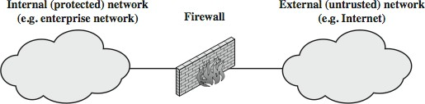
What is a Firewall?
Interconnects networks with differing trust
Only authorized traffic is allowed
Auditing and controlling access
Can implement alarms for abnormal behavior
Provides network address translation (NAT) and usage monitoring
Implements Virtual Private Networks (VPNs)

Slide 60
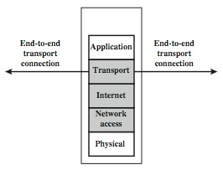
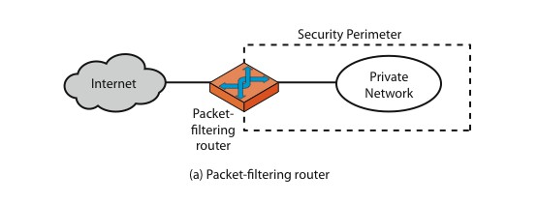
Firewalls – Packet Filters
Examine each IP packet (no context) and permit or deny according to the rules

Slide 61
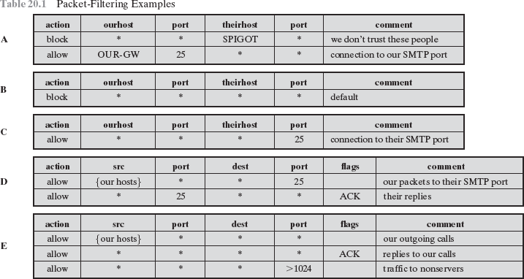
Firewalls – Packet Filters

Slide 62
Firewalls – Stateful Packet Filters
Examine each IP packet in its context
Keep track of client-server sessions
May even inspect limited application data

Slide 63
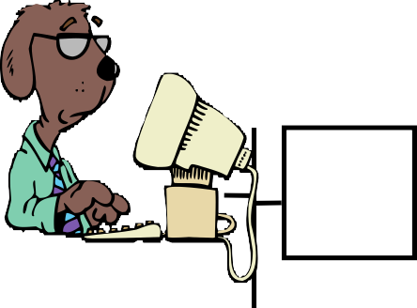
Proxy Servers
Specialized server programs
Take user's requests and forward them to real servers
Take the server's responses and forward them to users
Enforce site security policy ⇒ Refuse some requests.
Also known as application-level gateways
With special "Proxy client" programs, proxy servers are almost transparent.
Proxy
Server
R1
R2
Internet
Client
Proxy
Real

Slide 64
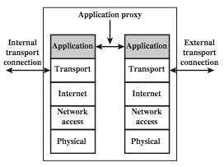
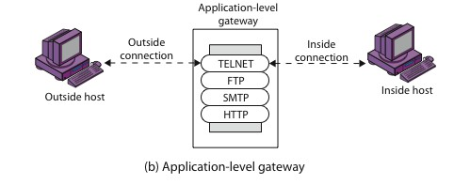
Application Level Gateway (Cont)
Inside Connection
Outside Connection
Inside Host
Outside Host

Slide 65
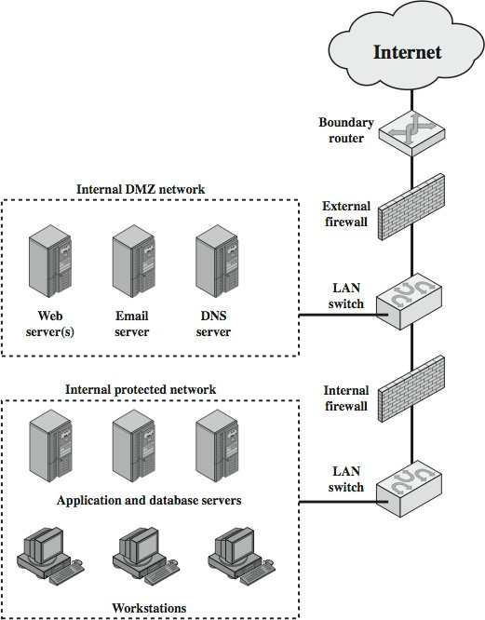
DMZ Networks
Demilitarized Zone

Slide 66
Firewall Limitations
It cannot protect from attacks bypassing it
E.g., sneakernet, utility modems, trusted organizations, trusted services (e.g., SSL/SSH)
It cannot protect against internal threats
E.g., disgruntled or colluding employees
It cannot protect against access via Wireless LAN
If improperly secured against external use, e.g., personal hot spots
It cannot protect against malware imported via laptops, PDAs, and storage infected outside

Slide 67
Intrusion vs. Extrusion Detection
Intrusion Detection: Detecting unauthorized activity by inspecting inbound traffic
Extrusion Detection: Detecting unauthorized activity by inspecting outbound traffic
Extrusion: Insider visiting a malicious website or a Trojan contacting a remote internet relay chat channel

Slide 68
Types of IDS
Signature-Based IDS: Search for known attack patterns using pattern matching, heuristics, protocol decode
Rule-Based IDS: Violation of security policy
Anomaly-Based IDS
Statistical or non-statistical detection. Now AI-based.
Response:
Passive: Alert the console
Reactive: Stop the intrusion ⇒ Intrusion Prevention System
⇒ Blocking
Snort: A wide-used open-source IDS Ref: http://en.wikipedia.org/wiki/Intrusion_detection_system, http://en.wikipedia.org/wiki/Intrusion_detection https://en.wikipedia.org/wiki/Snort_(software)

Slide 69
Honeypots
Decoy systems to lure attackers
Away from accessing critical systems
To collect information about their activities
To encourage the attacker to stay on the system so the administrator can respond
Are filled with fabricated information
Instrumented to collect detailed information on attackers’ activities
Single or multiple networked systems
Ref: http://en.wikipedia.org/wiki/Honeypot_(computing)

Slide 70
Firewalls and IDS: Summary
Firewalls separate networks of different trust levels
Some traffic, such as laptops, smartphones, and wireless can bypass the firewall
A firewall can be a simple packet filter or an application-level proxy
Intruders can be both internal, external, or organized
IDS can be signature-based, anomaly-based, or statistical
Honeypots can be used to detect intruders

Slide 71
Summary
Network security requires confidentiality, integrity, availability, authentication, and non-repudiation.
Encryption can use one secret key or two keys (public and private). The public key is very compute-intensive and is generally used to send the secret key.
The digital certificate system is used to certify the public key. Secure e-mail uses confidentiality using a secret key, uses certificates, and public keys to sign the e-mail and send the secret key.
The web uses SSL/TLS for transport-level security
IPsec/IKE is used for VPN
Firewalls and IDS are used for security protection.

Slide 72
Wireless Security
Ron's Cipher 4 (RC4)
Extensible Authentication Protocol (EAP)
RADIUS
Wired Equivalent Privacy (WEP)
Problems with WEP Authentication
802.11i Wireless LAN Security
Authentication and Key Derivation
WPA2 Four-Way Handshake
Authentication and Key Management in 4G/5G

Slide 73
Ron's Cipher 4 (RC4)
Developed by Ron Rivest in 1987. Trade secret. Leaked 1994.
Stream Cipher
A pseudo-random stream is generated using a given key and xor'ed with the input
Pseudo-random stream is called a One-Time pad
Key can be 1 to 256 octets
See the C code in the reference.
Encryption Key
K
Pseudo-random # generator
Random byte
b
Plain text data byte p
Cipher text data byte c
⊕

Slide 74




Extensible Authentication Protocol (EAP)
Old Methods: Password Authentication Protocol (PAP), Challenge Handshake Authentication Protocol (CHAP), Microsoft CHAP (MS-CHAP)
Each authentication protocol required a new protocol
⇒ Extensible Authentication Protocol
Allows using many different authentication methods
Components: Supplicant: User, Authenticator: Network edge device, Authentication Server.
Supplicant Authenticator Authentication Server
Authenticator does not have to know all the authentication methods
Ref: http://en.wikipedia.org/wiki/Extensible_Authentication_Protocol
©2024 Raj Jain

Slide 75



EAP over LAN (EAPOL)
EAP was designed for Point-to-point line
IEEE extended it for LANs ⇒ EAPOL
Added a few more messages and fields
EAPOL is part of EAP that runs over IEEE 802 protocols.
Supplicant
Authenticator (Access Point)
Authentication Server
EAP
EAPOL
RADIUS
Ref: http://en.wikipedia.org/wiki/Eapol

Slide 76
RADIUS
Remote Authentication Dial-In User Service
Central point for Authorization, Accounting, and Auditing data
⇒ AAA server
Network Access servers get authentication info from RADIUS servers
Allows RADIUS Proxy Servers ⇒ ISP roaming alliances
Uses UDP: In case of server failure, the request must be re-sent to backup ⇒ Application-level retransmission required
TCP takes too long to indicate failure
Proxy RADIUS
RADIUS
Network Access Server
Remote Access Server
User
Customer Network
ISP Net
Ref: http://en.wikipedia.org/wiki/RADIUS

Slide 77

Wi-Fi Operation
Station
Access Point
Access Points (APs) periodically broadcast a beacon with SSID (service set ID) and security level
Subscriber stations listen to these beacons, measure signal strength and determine which AP to join
Subscribers can also send a “Probe” to find APs in the neighborhood
AP authenticates the subscriber station using shared keys
Subscriber stations and AP exchange encrypted packets
Subscriber station send a “Disassociate” message and log off

Slide 78
Wired Equivalent Privacy (WEP)
WEP ⇒ Privacy similar to a wired network
First encryption standard for wireless. Defined in 802.11b
Provides authentication and encryption
Shared Key Authentication
⇒ All users and access points share a single key.

Slide 79
Problems with WEP Authentication
Record one challenge/response
Both plain text and encrypted text are available to an attacker
XOR the two to get the keystream
Use that keystream and IV to encrypt any subsequent challenges
Station
Access Point
Challenge
Response (Nonce RC4 encrypted under shared key)
(Nonce)
Decrypted nonce OK?

Slide 80
WEP Problems
No centralized key management
Manual key distribution ⇒ Difficult to change keys
Single set of Keys shared by all ⇒ Frequent changes necessary
No mutual authentication
No user management (no use of RADIUS)
Directly uses the master key
No protection against replay
Ref: http://en.wikipedia.org/wiki/Wireless_security, http://en.wikipedia.org/wiki/Wireless_LAN_security, http://en.wikipedia.org/wiki/Cracking_of_wireless_networks

Slide 81
802.11i Wireless LAN Security
Wi-Fi Alliance Wi-Fi Protected Access (WPA) Software modification to existing WEP systems Temporal Key Integrity Protocol (TKIP)
Key mixing function to generate per packet key
Sequence Number to protect against replay attacks
64-bit message integrity check (MIC)
Uses the same RC4 encryption
802.11i Robust Security Network (RSN) or WPA2
Requires hardware replacement
Counter Mode with Cipher Block Chaining Message Authentication Code Protocol (CCMP)
AES encryption with counter mode
Ref: http://en.wikipedia.org/wiki/IEEE_802.11i-2004,
http://en.wikipedia.org/wiki/Temporal_Key_Integrity_Protocol, http://en.wikipedia.org/wiki/CCMP

Slide 82











Authentication and Key Derivation
wired network
AS
Authentication Server
Mobile AP
Security Capabilities
Mutual Authentication and Shared Symmetric Key Derivation
Shared Sym. Key Distribution
Encrypted Comm.

Slide 83


WPA2 Four-Way Handshake
Mobile M
Authentication Server AS
nonce_{AS}, MACAdr_{AS}
Generate PTK
nonce_{M}, MACAdr_{M,} HMAC_{PTK}(nonce_{AS,} shared secret) HMAC_{PTK}(nonce_{M}) ⇒I know PTK ⇒Authenticates AS
Generate PTK
GTK, MIC
ACK
Pair-wise transient key (PTK)
=f(shared secret, Nonce_{AS}, MACAdr_{AS}, Nonce_{M}, MACAdr_{M})
PTK is used for unicasts.
Group Temporal Key (GTK) is used for multicast
Ref: http://en.wikipedia.org/wiki/IEEE_802.11i-2004
http://www.cse.wustl.edu/~jain/cse473-24/
©2024 Raj Jain

Slide 84








Authentication and Key Management in 4G
Home Subscriber
MM
I want to attach. Here is my IMSI
BS
UE X wants to attach. Here is its IMSI
MME
Service (HSS)
How do I authenticate UE X?
Here is its IMSI and Visited Net
K_{HSS-M}{IMSI, nonce},
Exp_resp, Keys
Auth_Token
K_{HSS-M}{IMSI, nonce}
Auth_Token
K_{HSS-M}{IMSI, nonce}
c. Resp_{M} =K_{HSS-M}{Nonce}
Resp =K {Nonce}
M HSS-M
d. Resp is ok. Here are the keys.
Resp is ok.
e. Key Derivation using AES
Separate keys for data and control
K_{HSS-M} is the secret shared by HSS and Mobile

Slide 85
Authentication and Key Management in 5G
Several options:
Same as in 4G
4G scheme implemented using EAP. So the authenticator does not know the secret or the algorithm.
IoT device authentication. No pre-shared keys.
Use Public Key so IMSI is not transmitted in clear text.

Slide 86
Review: Wireless Security
RADIUS allows the use of centralized authentication servers.
EAP allows authenticators not to know the secrets or the algorithm.
Wi-Fi’s initial security using WEP failed and resulted in several inventions in authentication and key management
WPA2 used stronger encryption, dynamic keys, and several keys derived from the shared secrets. It also used the RSA algorithm in place of RC4
In 4G/5G, HSS serves as the authentication server and MME as an authenticator
In 5G, additional methods for IoT have been introduced. Also, EAP is allowed.
Notes:
Review Section 8.8 and do R19 through R27

Slide 87
Acronyms
3DES
AES
AH
ASCII
CA
CBC
CER
CRC
DA
DER
DES
D-H
DoS
ESP
FIPS
HMAC
Triple DES
Advanced Encryption Standard Authentication Header
American Standard Code for Information Interchange Certificate authority
Cipher Block Chaining (CBC) A filetype for certificates Cyclic Redundancy Check Destination Address
Distinguished Encoding Rules (used in X.509) Data Encryption Standard (DES)
Diffie-Hellman Denial of Service
Encapsulating Security Payload
Federal Information Processing standard Hash-based Message Authentication Code

Slide 88
Acronyms (Cont)
HTTP
HTTPS
HW
ICV
ID
IDEA
IDS
IETF
IKE
IKEv2
IPsecSecure IP
IPv4
IPv6
ISAKMP
IV
Hypertext Transfer Protocol
Hypertext Transfer Protocol with Security Hardware
Integrity Check Value Identifier
International Data Encryption Algorithm Intrusion Detection System
Internet Engineering Task Force Internet Key Exchange
Internet Key Exchange version 2
Internet Protocol version 4 Internet Protocol version 6
Internet Security and Key Management Protocol Initialization Vector
❑ LAN
Local Area Network

Slide 89
Acronyms (Cont)
MAC Message Authentication Code
MacOS Mac Operating System
MD4 Message Digest 4
MD5 Message Digest 5
MIME Multipurpose Internet Mail Extensions
MIT Massachusetts Institute of Technology
MTU Maximum Transmission Unit
NAT Network Address Translation
NIST National Institute of Standards and Technology
OCR Optical Character Recognition
OpenPGP Open PGP
PGP Pretty Good Privacy
RC2 Ron’s Code 2
RC4 Ron’s Code 4
RFC Request for Comment
❑ RSA
Rivest, Shamir, Adleman

Slide 90
Acronyms (Cont)
SA
SHA
SPI
SSH
SSL
SW
TA
TCP
TFC
TLS
TLV
UDP
US
VPN
WEP
XOR
WUSTL
Security Association Secure Hash
Security Parameter Index Secure Shell
Secure Socket Layer Software
Teaching Assistant Transmission Control Protocol Traffic Flow Confidentiality Transport Level Security
Type-Length-Value Universal Datagram Protocol United States
Virtual Private Network Wired Equivalent Privacy Exclusive OR
^{Washington Univer}h^{s}tt^{i}p^{t}:/^{y}/ww^{in}w.c^{S}se^{t}.w. u^{L}stºl.e^{u}du^{i}/^{s}~jain/cse473-24/

Slide 91

To Prof. Raj Jain http://rajjain.com

